Slide 1



Welcome to Year 1
Webster Class
This year our classes are named after people who have overcome challenges in their lives and become pioneers for inclusion.
George Webster is a BAFTA-winning Cbeebies presenter and children's author who has Downs syndrome.

Slide 2
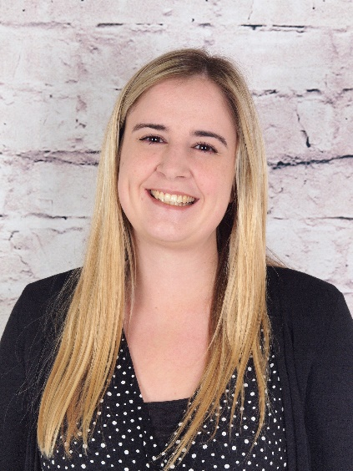
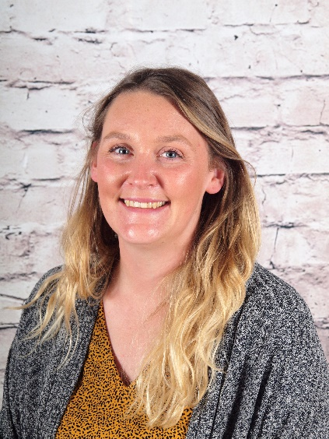
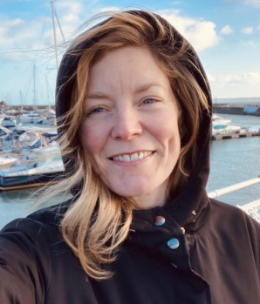
Who’s Who
Teachers:
Mrs Deakin (Monday – Wednesday)
Mrs Ball (Thursday – Friday)
Teaching assistant:
Miss Throp

Slide 3
Key times
Doors open at 8:30am until 8:40am
Please drop your child off at the outside door of their classroom. We will help them put
their things away and get started with an activity.
KS1 break is at 10:15am
KS1 have healthy snacks of fruit or vegetables provided daily – if your child brings their own snack, this can be fruit, veggies, cheese, yogurt or plain rice cakes.
KS1 lunch is at 11:45am
All pupils in KS1 can have a free school meal – choose from the daily hot option, a baguette or a jacket potato with a choice of filling. Children may bring a packed lunch from home if they prefer.
Pick up is at 3:10pm
In KS1 your child will be called to come outside to meet you once their adult is seen
waiting outside the classroom.
A range of clubs run from 3:10 – 4:10pm
These will be allocated each half-term – keep an eye out for the booking letter. ☺

Slide 4
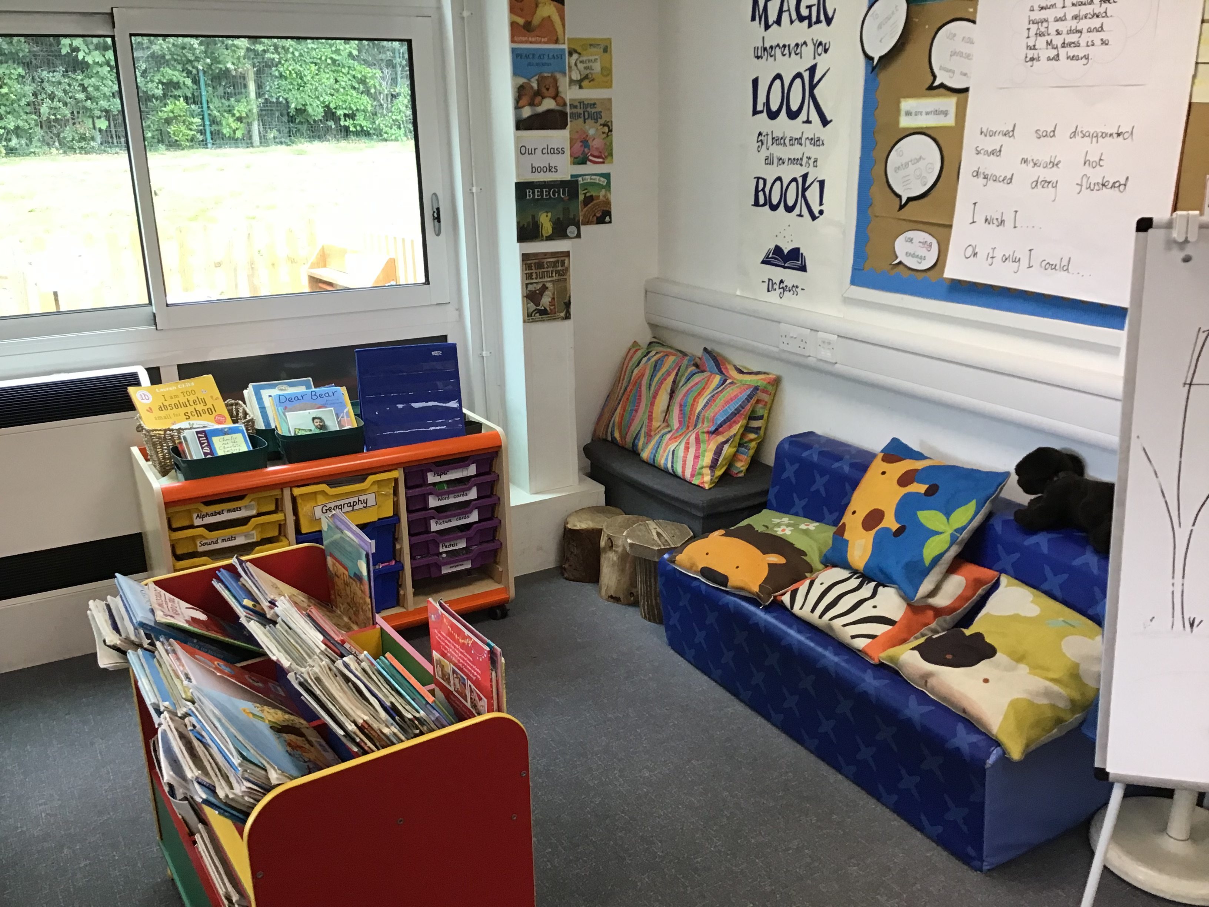
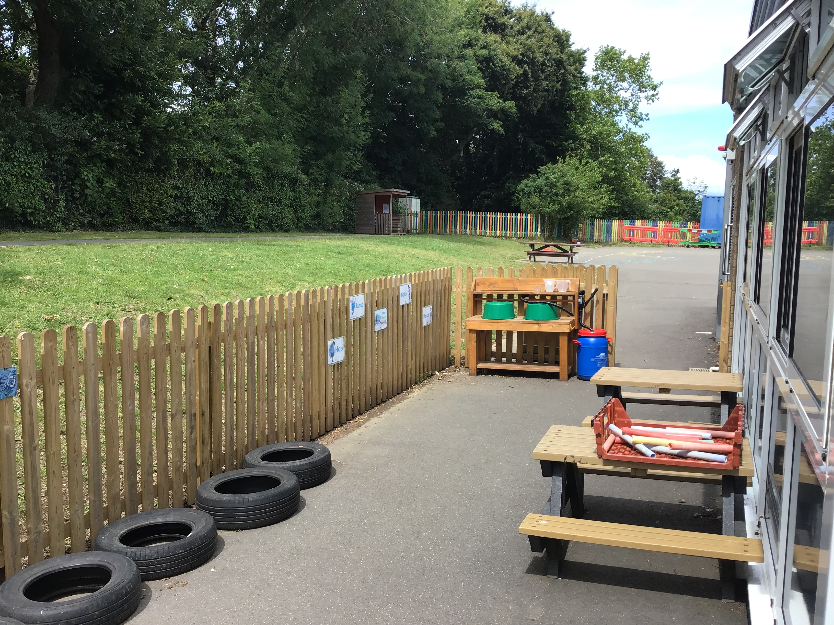
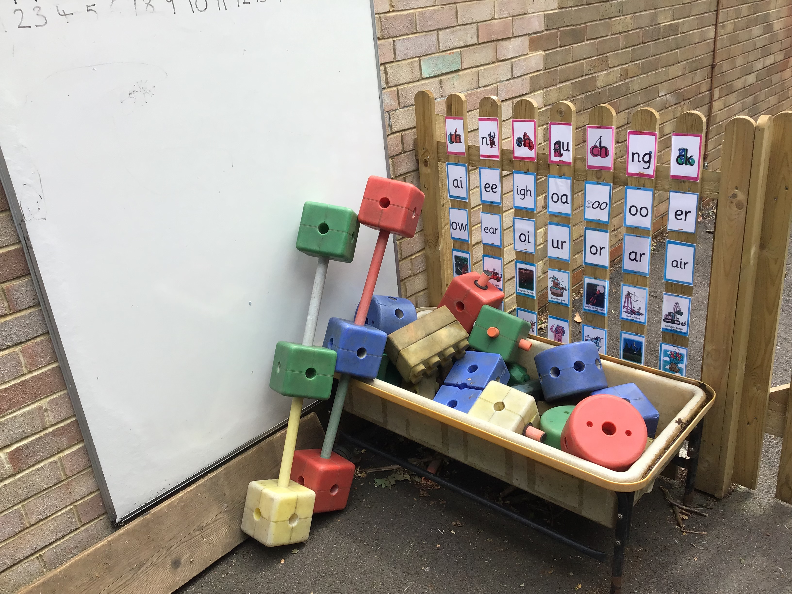
Transition to Year 1
Learning in reception is play-based. Play-based learning will carry on for at least the first two half-terms in Year 1 to support children with the transition.
After Christmas, the learning in Year 1 begins to become more formal and adult-directed. The transition from play-based learning to more formal learning is very gradual.
Talk positively about the move to year 1 with your child: ‘It will be exciting to learn about new things, won’t it?’. We are always here to help so do let us know if there are any worries or questions ☺
In Year 1 your child’s learning will be recorded in exercise books. Don’t worry, you will have plenty of opportunities to look at these throughout the year. Remember to look at the newsletter every week too, which will tell you more about the learning in Year 1.

Slide 5


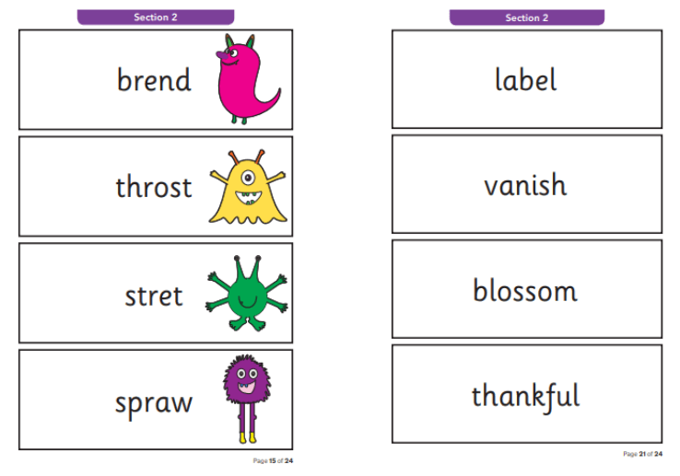
Reading / Phonics
We will continue to learn new phonic sounds for reading in Year 1. We will have phonics lessons daily. For more information and resources about our phonic programme please see: https://www.littlewandlelettersandsounds.org.uk/resources/for-parents/
We will also continue to practise Common Exception Words or “tricky” words where the spelling pattern does not easily match learned phonics.
The children will also make predictions, recall the main events in a narrative, ask questions and express opinions about stories.
The best way to support your child with phonics is by reading lots! Listen to your child read everyday, but remember to read and enjoy stories together too!
The children will complete a phonics screening check at the end of Year 1 which will assess their phonic knowledge– this is nothing to worry about and will take place as part of normal classroom practice.

Slide 6
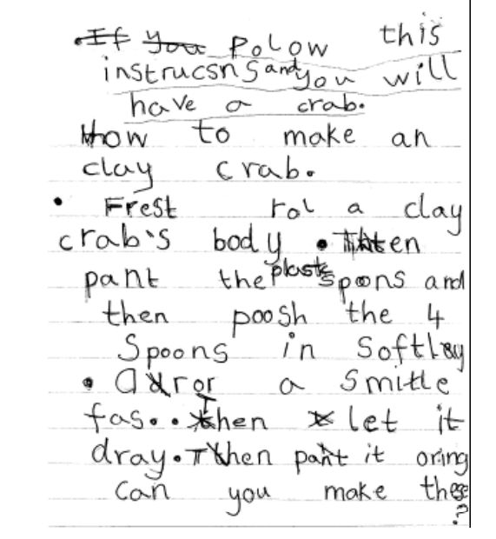
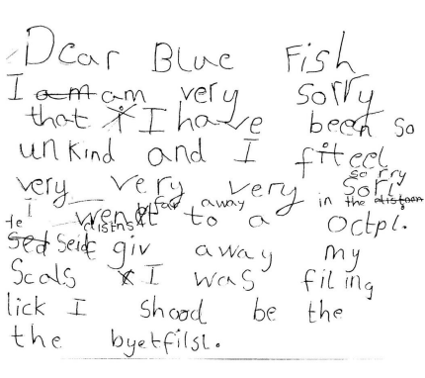
Writing
In Year 1, these are the areas we will focus on in writing:
  Sit correctly at a table, holding a pencil comfortably and correctly
  Finger spaces
  Full stops
  Capital letters
  Join clauses using ‘and’
  Use –ing and –ed endings
  Begin to use question marks
  and exclamation marks

Slide 7







These are a few of the books we will be using to inspire our writing this year:

Slide 8
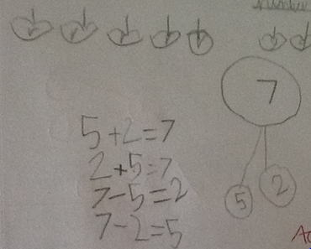
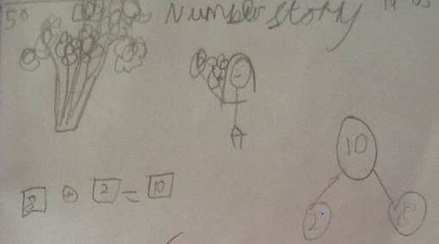
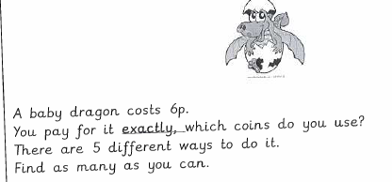
Maths
In Year 1 children will learn to:
Count forwards and backwards to 100.
Add and subtract one-digit and two-digit numbers to 20.
Count in 2s, 5s and 10s.
Recognise and find half and quarter of an object, shape or quantity.
Recognise common 2D and 3D shapes.
Measure and compare mass, volume and height.
Tell the time to the hour and half past the hour.

Slide 9

We will use a wide range of practical resources to support our work in Maths throughout the year.
This helps children to create a strong visual image of what the maths they are doing represents.

Slide 10
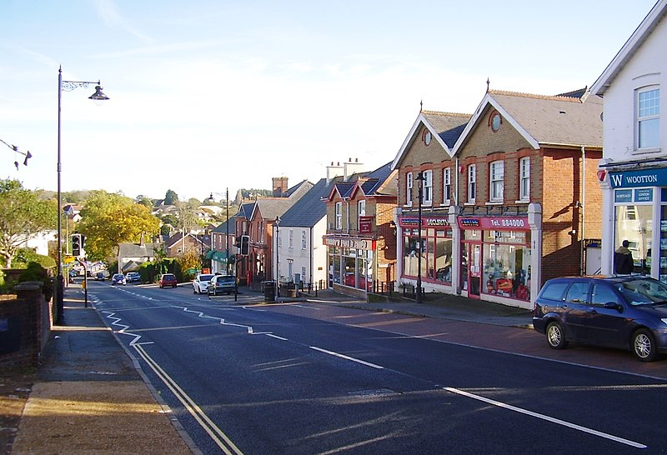

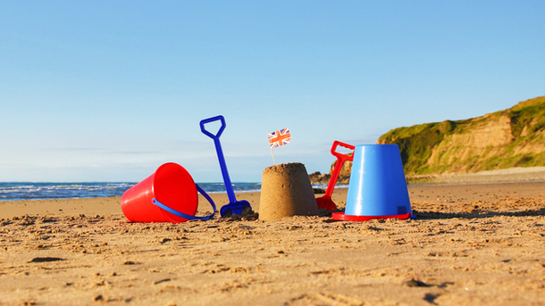
Wider curriculum
Our topics this year will include:
Explorers Our local area The seaside
Year 1 will be taught Science, History, Geography, Music, Computing, PSHE,
RE, Art, DT, and PE.

Slide 11


Homework
The only homework in Year 1 is reading – your child reading their phonic book to you, and you reading and enjoying books together ☺
The expectations are:
Daily reading
(aim for 2+ pages or 5 minutes)
During the year we will also introduce an online Maths game called Numbots for those who wish to play at home.

Slide 12
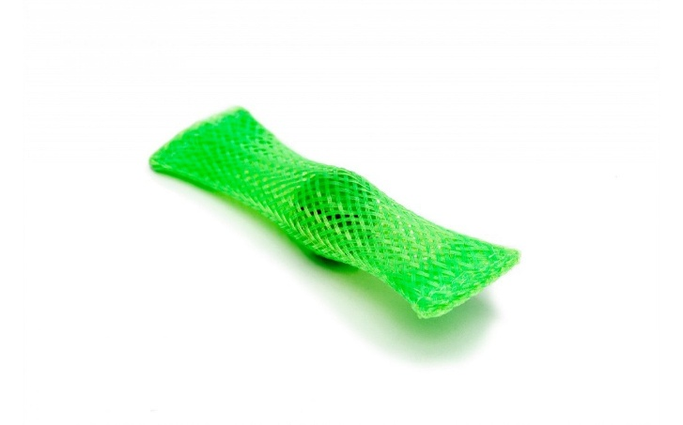

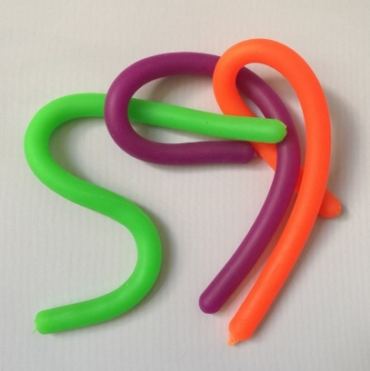
Fidget Tools
Some children are offered a ‘fidget tool’ in class to keep their hands busy while needing to focus for a longer period of listening
These will be given out by the school, as judged beneficial by the class teacher or SENco
Please do not send in a fidget toy from home, but if you suspect your child may benefit from one, you are welcome to drop us an email and we will monitor their needs and supply one if we feel it will have a beneficial effect. In practice, some children are more distracted by the fidget item itself than they are without it!
We have other tools in school that can support children, especially those with Special Educational Needs and Disabilities, which will be provided as necessary

Slide 13

Assessment
We assess the children throughout the year taking into account their work in books and their contributions in class.
There are two formal parents’ evenings in the Autumn and Spring terms; these are an opportunity to discuss progress, successes, areas for development and strategies moving forward alongside any pastoral areas. Your child’s individual targets will also be shared with you at these meetings.
There is an additional open evening for parents in the Summer term to visit your child’s current class teacher and/or meet the new teacher for the coming year.
Formal reports are produced during the Summer term and will give an overview of your child’s attainment in all subjects, a personal comment from the teacher and Headteacher, and targets for the year ahead.
Towards the end of Year 1, the class will complete a phonics screening check. This involves reading 40 words (20 real words and 20 pseudo words).

Slide 14

Communication
Please contact the class teacher first with any questions or worries.
For short questions / messages:
catch us at drop-off or pick-up times,
use the class email address year1@woottonpri.iow.sch.uk (checked 8:30 – 4:00),
pop a note into the reading diary for any non-urgent queries.
For longer conversations:
please arrange with the class teacher to meet after school or talk on the phone.
Our weekly newsletter includes an update from each teacher on what the children have been learning alongside important messages from the Headteacher.
Please keep the office updated with your contact details so you don’t miss any important messages ☺

Slide 15
We are looking forward to a fantastic year in
Webster Class ☺
Please feel free to ask any questions now, pop them on a post-it, or in a email.
Thank you!

