Slide 1
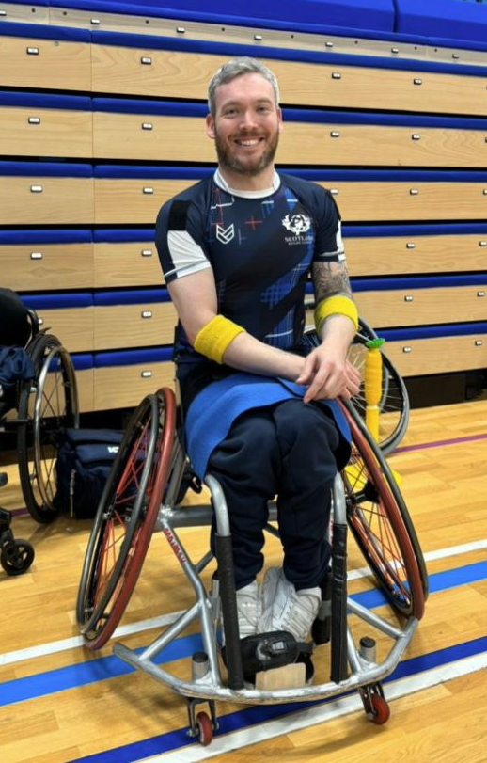

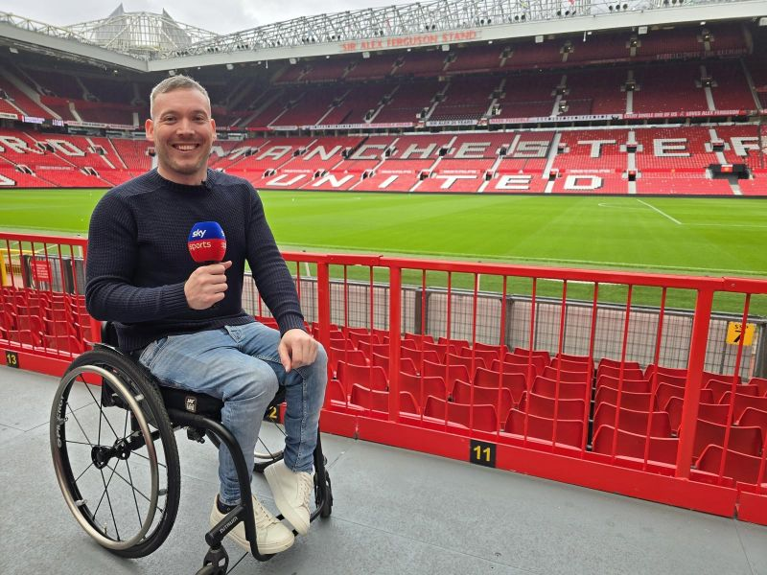
Welcome to Year 2
Dougan Class
This year our classes are named after people who have overcome challenges in their lives and become pioneers for inclusion.
Martin Dougan is CBBC and sports presenter, and wheelchair basketball athlete who has Cerebral Palsy.

Slide 2
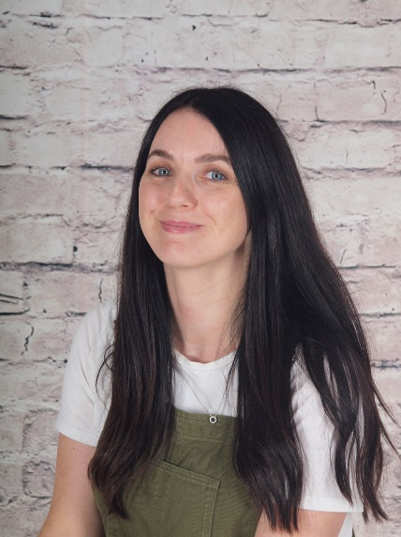
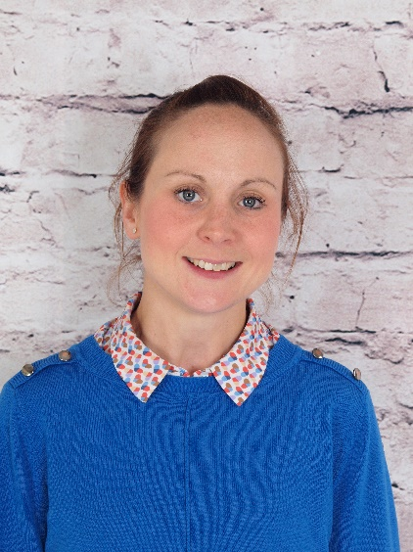
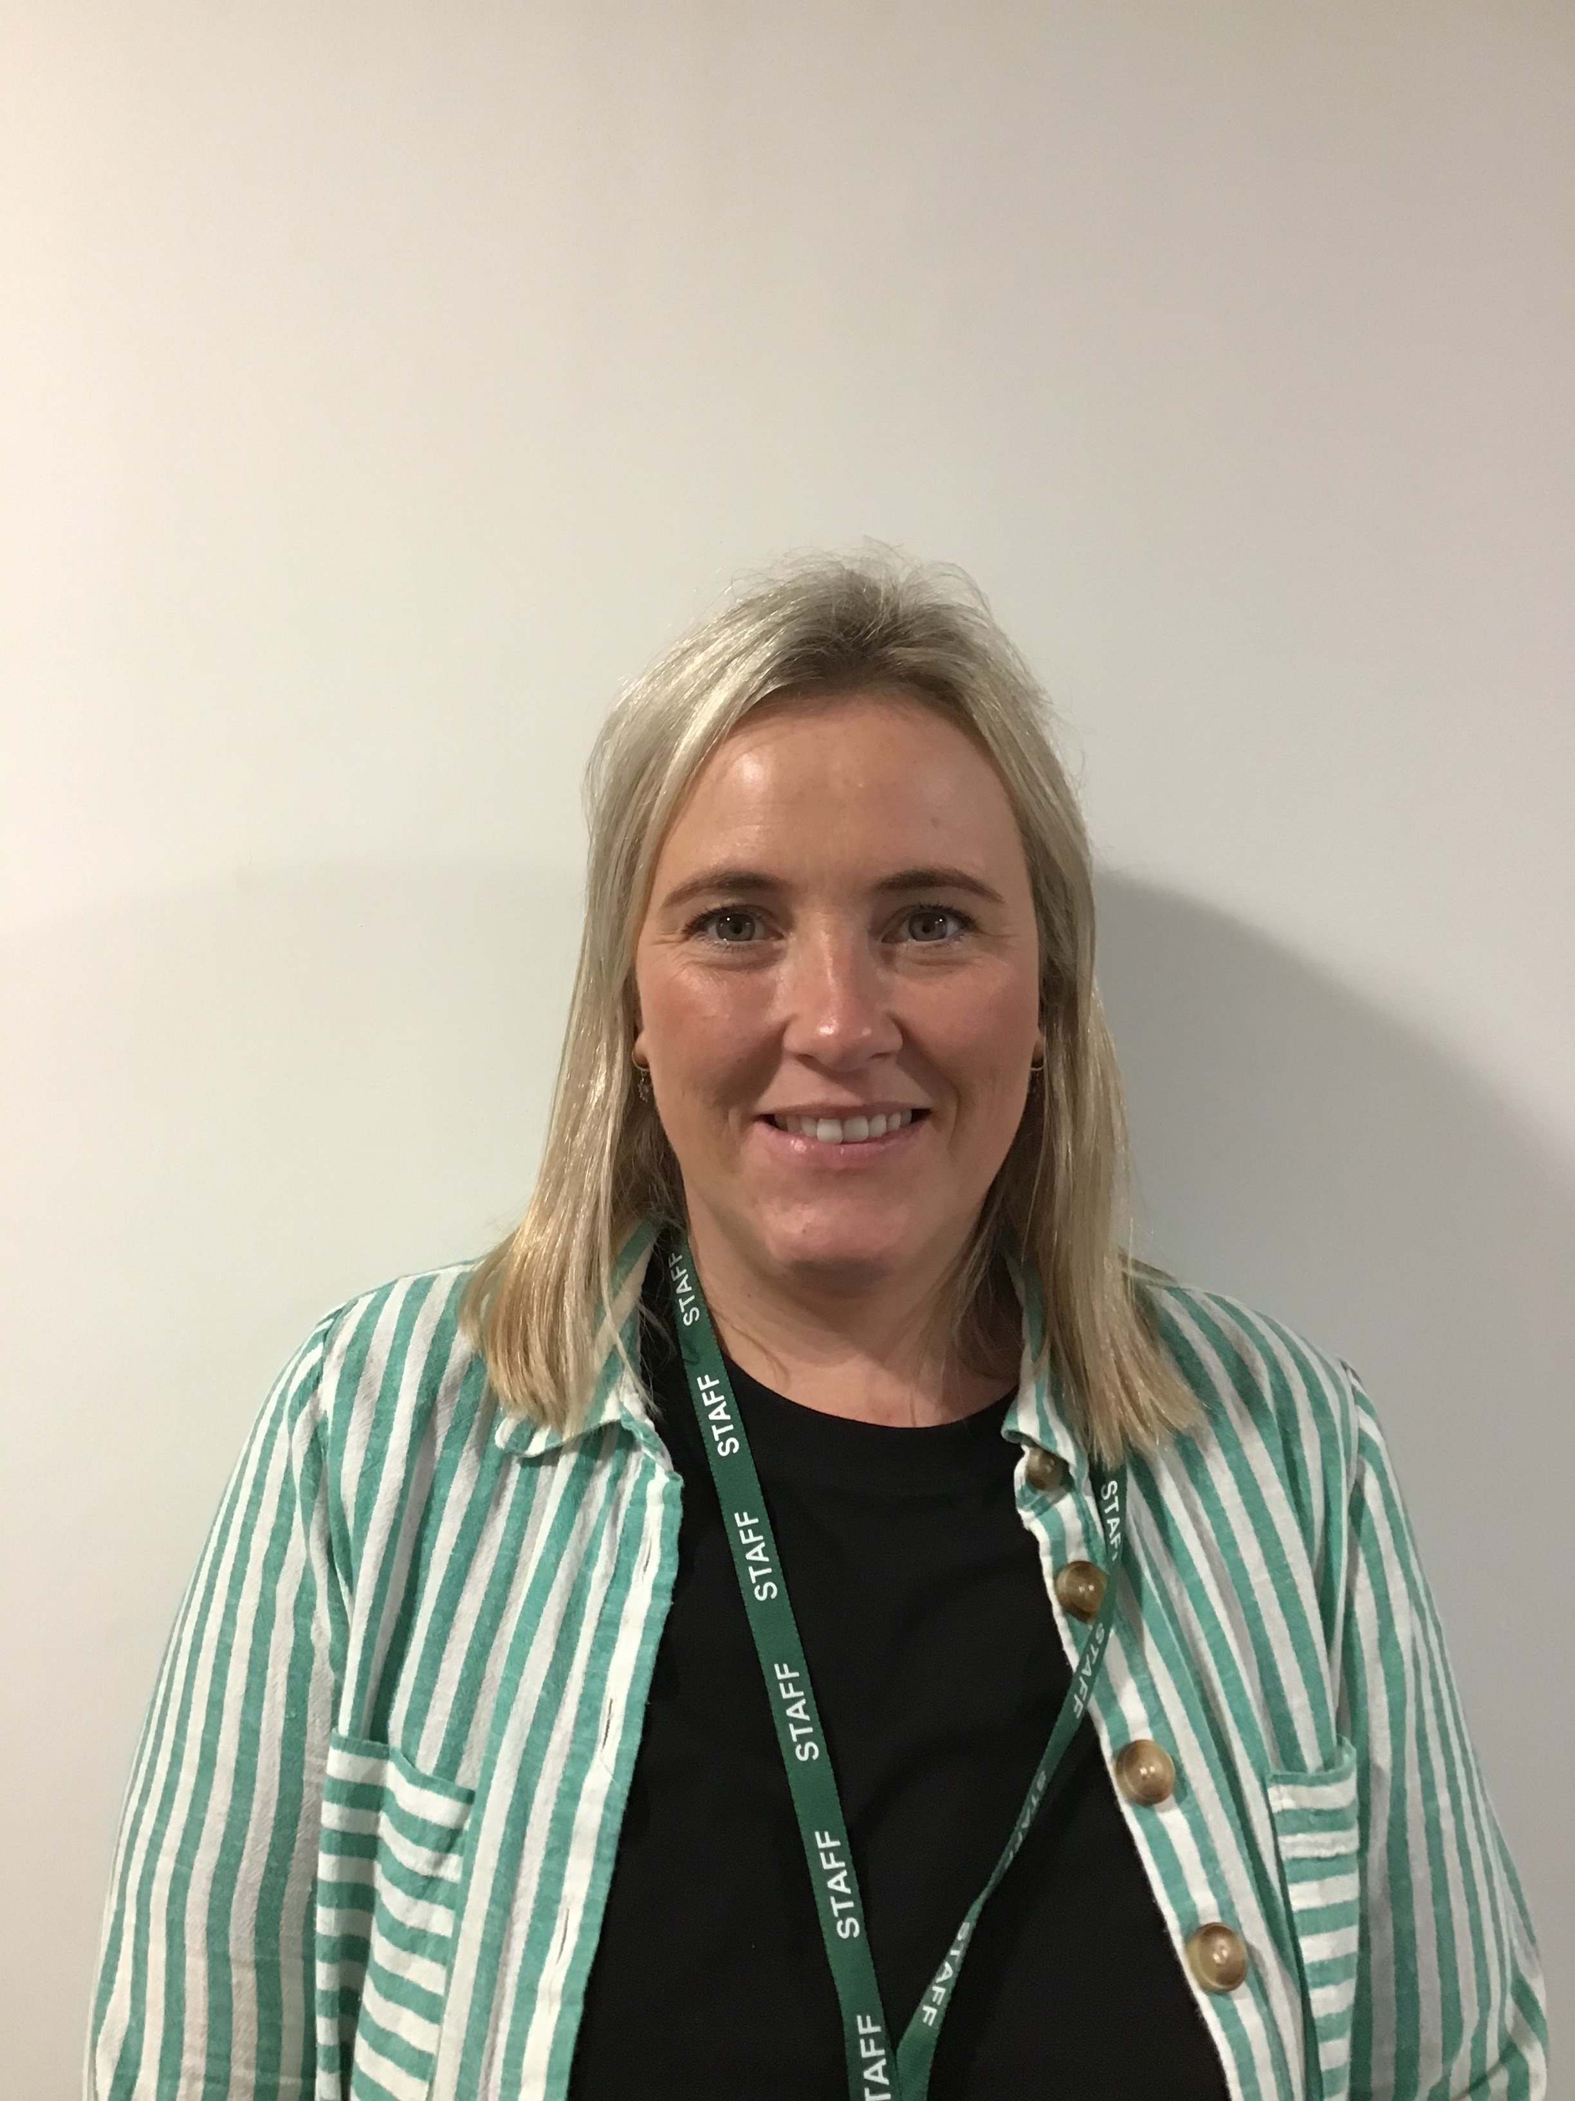
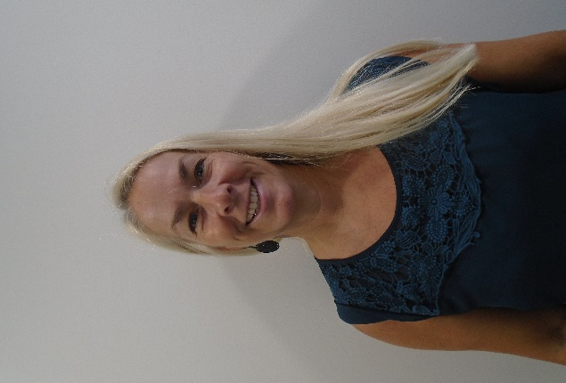
Who’s Who
Teacher:
Miss Cooke
Teaching assistant:
Mrs Shaw
Miss Hasson
Mrs Lacey

Slide 3
Key times
Doors open at 8:30am until 8:40am
Please drop your child off at the outside door of their classroom. It is useful to arrive in good time if possible as we have learning activities out to complete before the register
KS1 break is at 10:15am
KS1 have healthy snacks of fruit or vegetables provided daily – if your child brings their own snack this can be fruit, veggies, cheese, yogurt or plain rice cakes.
KS1 lunch is at 11:45am
All pupils in KS1 can have a free school meal – choose from the daily hot option, a baguette or a jacket potato with a choice of filling Children may bring a packed lunch from home if they prefer
Pick up is at 3:10pm – gates open at 3:05pm
In KS1 your child will be called once their adult is seen waiting outside the classroom
A range of clubs run from 3:10 – 4:10pm
These will be allocated each half-term – keep an eye out for the booking letter ☺

Slide 4

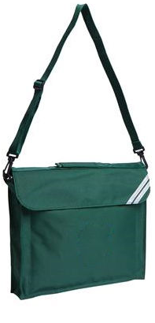
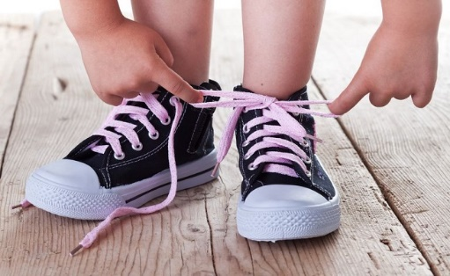

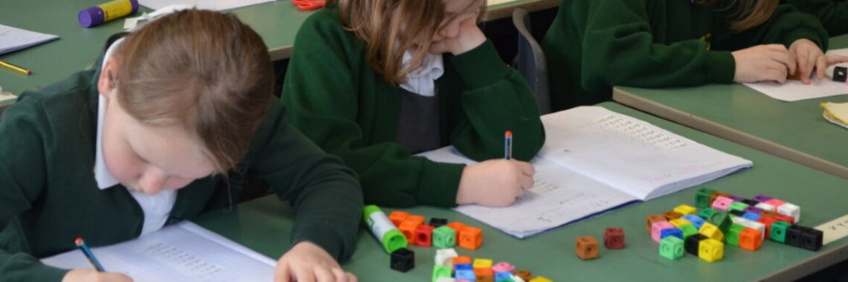
Developing independence
Year 2 is an important year for developing independence
Throughout the year you will notice this and should encourage it
Help your child to learn to organise their own belongings and take responsibility for their own learning
Although we always make learning lots of fun, Year 2 is a bit more formal than Year 1 and children may be more tired than usual to begin with. However, this tends to settle down after the first half-term and everyone always makes huge progress during Year 2.
I am sure that the children will be surprising all of us with their learning by Christmas!

Slide 5
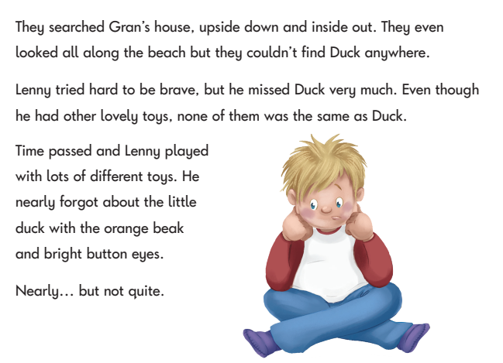
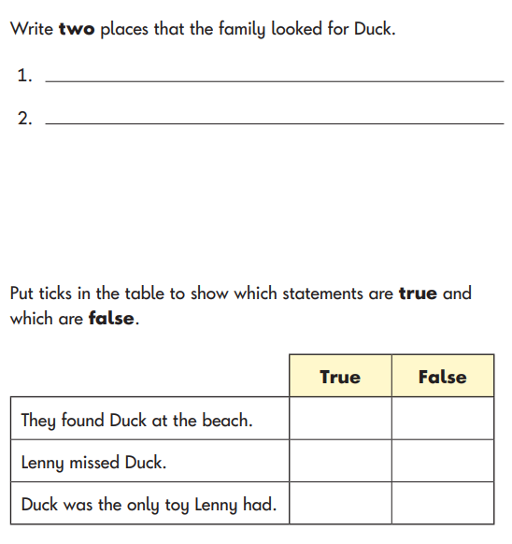
Reading / Phonics
We will continue to learn new phonic sounds for reading including alternative spellings of the same sound
We will also continue to practise Common Exception Words or “tricky” words where the spelling pattern does not easily match learned phonics
The children will also begin to discuss what they are reading in more depth, making inferences about characters’ thoughts, feelings and actions.
Towards the end of the year, the class will complete some special reading booklets which will form part of their KS1 reading assessment alongside their teacher’s judgement. These are nothing to worry about and will be completed as part of normal class activities.

Slide 6
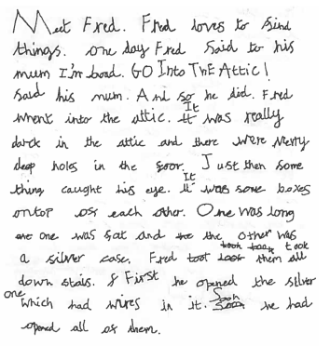
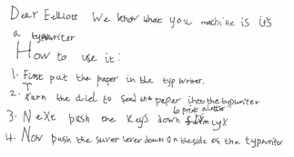
Writing
In Year 2 we often see children’s writing take off!
Now that most children are using basic punctuation and their phonic sounds to spell, we will start to focus on writing longer pieces with:
  different types of sentences
  a wider range of punctuation
  effective language choices
  detail to describe

Slide 7








These are a few of the books we will be using to inspire our writing this year

Slide 8


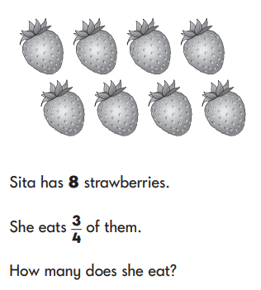
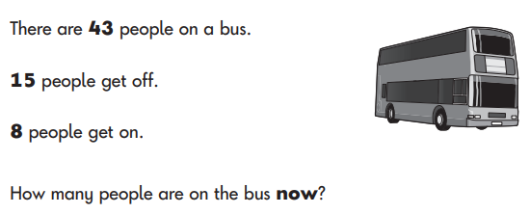

Maths
In Year 2 we will build on children’s understanding to work with numbers up to 100 and beyond.
We will practise addition and subtraction of 2-digit numbers using different methods.
We will develop multiplication and division strategies, and learn the 10, 5 and 2x tables.
We will also deepen our learning on fractions, measurement and geometry.
Towards the end of the year, the class will complete some special Maths booklets which will form part of their KS1 Maths assessment alongside their teacher’s judgement. These are nothing to worry about and will be completed as part of normal class activities.

Slide 9
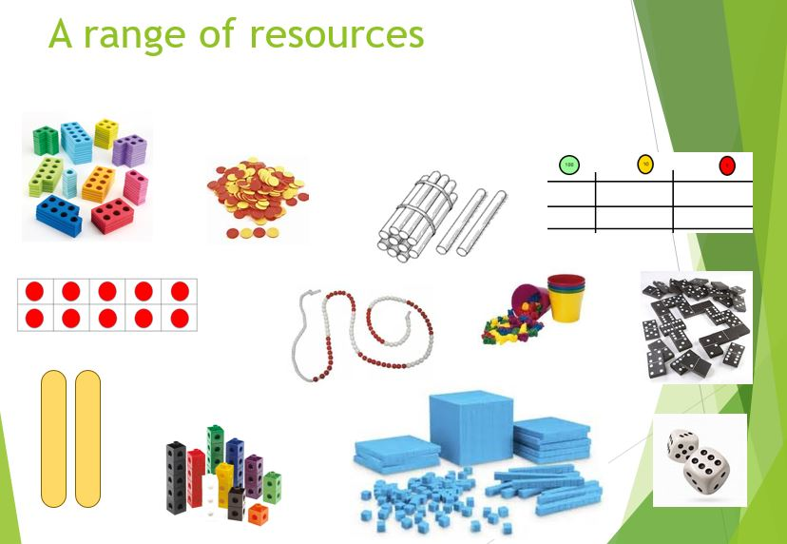
We will use a wide range of practical resources to support our work in Maths throughout the year.
This helps children to create a strong visual image of what the maths they are doing represents.

Slide 10
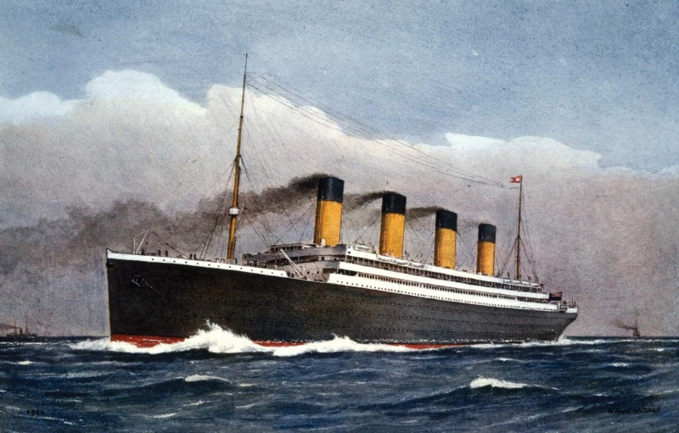


Wider curriculum
We have lots of interesting topics in store this year. Our learning will include:
The Titanic Malaysia
Year 2 will be taught Science, History, Geography, Music, Computing, PSHE, RE, Art, DT, and PE each week.
The Great Fire of London

Slide 11


Homework
In Year 2 we try to keep homework to a minimum, but it really does make such a difference to your child’s progress if you support their learning at home where you can.
The expectations are:
Daily reading
(aim for ten minutes a day)
Maths facts practice
(via Numbots – aim for 3 times a week)
As the year progresses, we will add weekly spelling practice

Slide 12
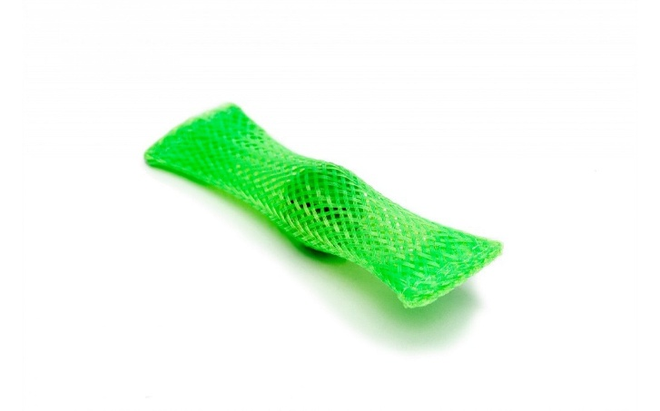
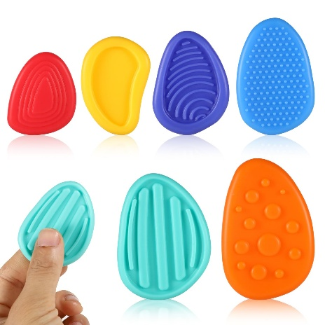
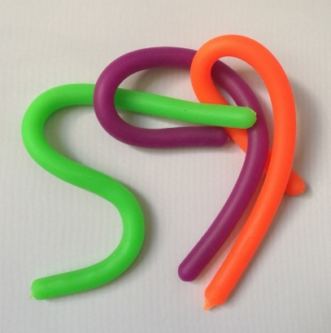
Fidget Tools
Some children are offered a ‘fidget tool’ in class to keep their hands busy while needing to focus for a longer period of listening
These will be given out by the school, as judged beneficial by the class teacher or SENDCO
Please do not send in a fidget toy from home, but if you suspect your child may benefit from one, you are welcome to drop us an email and we will monitor their needs and supply one if we feel it will have a beneficial effect. In practice, some children are more distracted by the fidget item itself than they are without it!
We have other tools in school that can support children, especially those with Special Educational Needs and Disabilities, which will be provided as necessary

Slide 13
Assessment
I can’t do it …YET!
We assess the children throughout the year taking into account their work in books, their contributions in class and their results in any assessment booklets.
There are two formal parents’ evenings in the Autumn and Spring terms; these are an opportunity to discuss progress, successes, areas for development and strategies moving forward alongside any pastoral areas. Your child’s individual targets will also be shared with you at these meetings.
There is an additional open evening for parents in the Summer term to visit your child’s current class teacher and meet the new teacher for the coming year.
Formal reports are produced during the Summer term and will give an overview of your child’s attainment in all subjects, a personal comment from the teacher and Headteacher, and targets for the year ahead.
Towards the end of Year 2, the class will complete some special Reading, Maths and Grammar, Punctuation and Spelling booklets which will form part of their KS1 assessment alongside their teacher’s judgement. These are nothing to worry about and will be completed as part of normal class activities.
Any pupils who did not score 32/40 in their phonic screening check will also be given the opportunity to take this again during Year 2.

Slide 14

Communication
Please contact the class teacher first with any questions or worries.
For short questions / messages:
catch us at drop-off or pick-up times,
use the class email address year2@woottonpri.iow.sch.uk (checked 8:30 – 4:00),
pop a note into the reading diary for any non-urgent queries.
For longer conversations:
please arrange with the class teacher to meet after school or talk on the phone.
Our weekly newsletter includes an update from each teacher on what the children have been learning alongside important messages from the Headteacher.
The school facebook page also celebrates learning each week and often includes photographs of the children enjoying their lessons and educational visits.
Please keep the office updated with your contact details so you don’t miss any important messages ☺

Slide 15
We are looking forward to a fantastic year in
Dougan Class ☺
Please feel free to ask any questions now, pop them on a post-it, or drop me an email:
year2@woottonpri.iow.sch.uk
Thank you!

