Slide 1

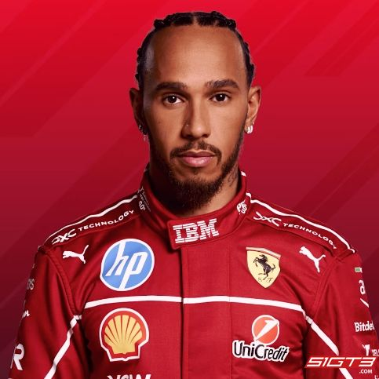
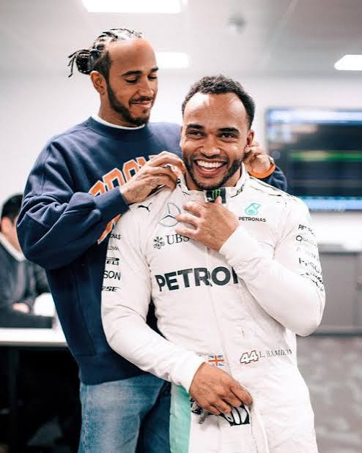
Welcome to Year 3
Hamilton Class
This year our classes are named after people who have overcome challenges in their lives and become pioneers for inclusion. Lewis Hamilton is a 7-time Formula 1 World Champion who has Dyslexia.
He is also a strong supporter of his brother’s racing career – Nicholas Hamilton has Cerebral Palsy.

Slide 2
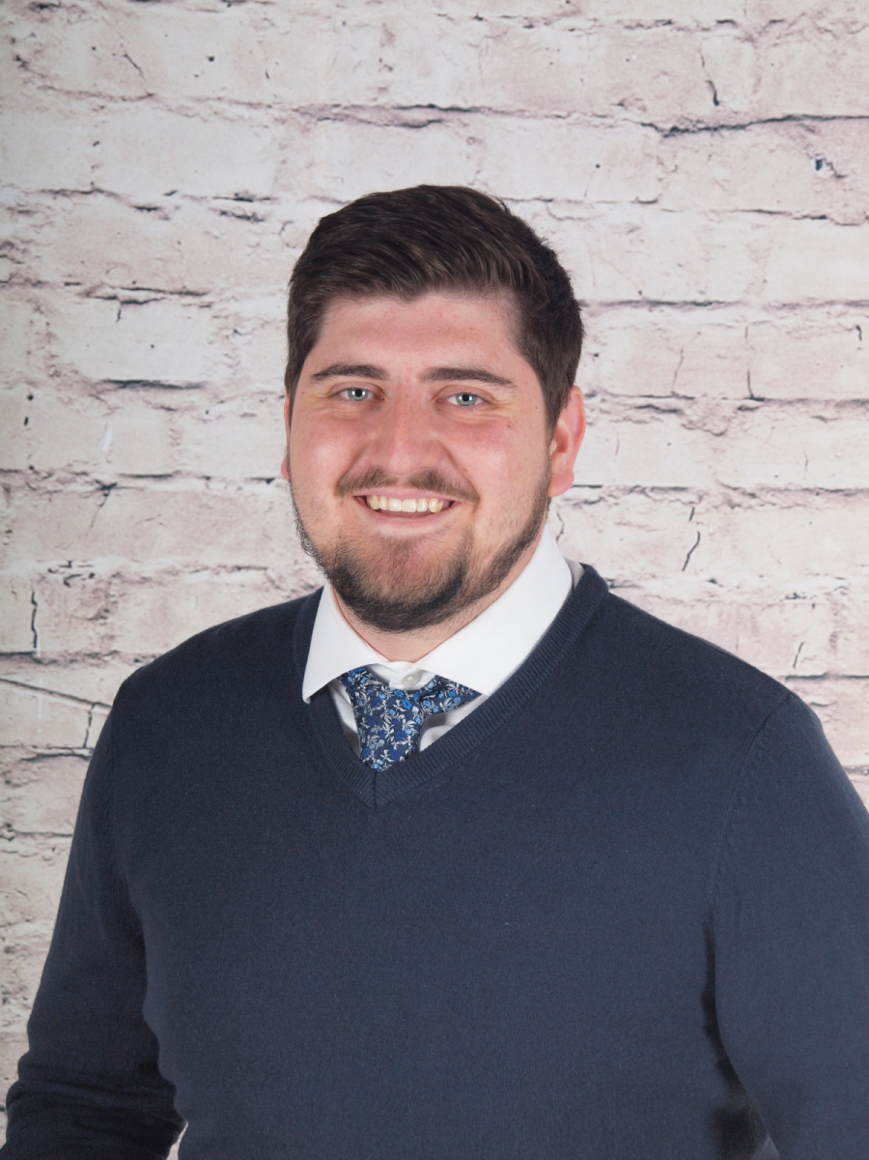
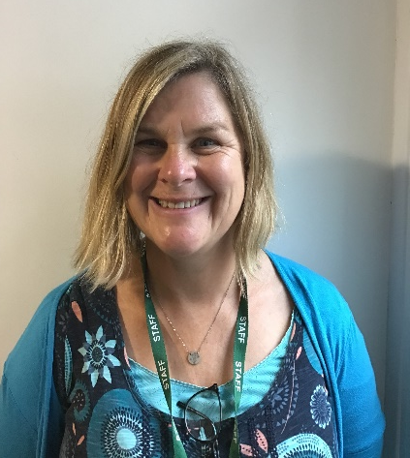
Who’s Who
Teacher:
Mr Scurr
Teaching assistant:
Mrs James

Slide 3
Key times
Doors open at 8:30 am until 8:40 am
Please drop your child off at the outside door of their classroom. It is useful to arrive in good time as we have learning activities out to complete before the register.
KS2 break is at 10:35am
KS2 have healthy snacks of fruit or vegetables provided – if your child brings their own snack this can be fruit, veggies, cheese, yogurt or plain rice cakes.
KS2 lunch is at 12:15pm
Children in KS2 do not get a free school meal (unless entitled to FSM). Families are able to pay for a school dinner, or children may bring a packed lunch.
Pick up is at 3:10pm – gates open at 3:05pm
In KS2 your child will be called once their adult is seen waiting outside the classroom.
A range of clubs run from 3:10 – 4:10pm
These will be allocated each half-term – keep an eye out for the booking letter ☺

Slide 4

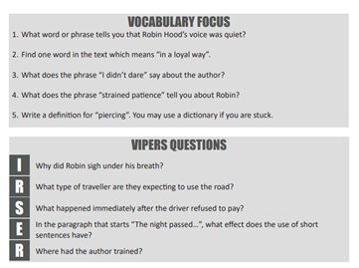
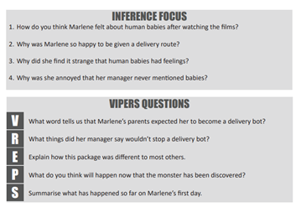
Reading / Spelling
We will continue to revisit any phonic rules children have not yet secured and continue to learn spelling rules.
We will also continue to practise Common Exception Words or “tricky” words where the spelling pattern does not easily match learned phonics.
The children will also have daily guided reading sessions where we will look at the reading skills such as; word reading, retrieval, inference, prediction and compare and contrast.

Slide 5
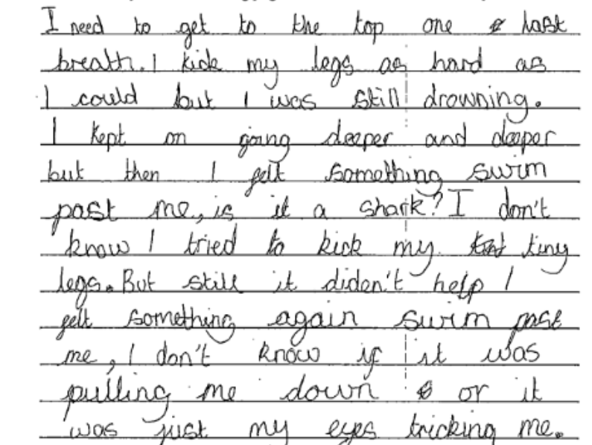
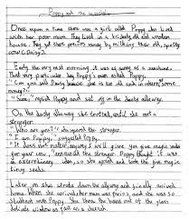

Writing
In our English lessons we will be looking at writing n many different forms. Throughout the year the children will be taught to:
Generate their own ideas when writing.
Consistently use a range of conjunctions and adverbs.
Use adjectives for impact and effect.
Use inverted commas to show direct speech.
Group ideas into basic paragraphs.
Write with increasingly legibility, consistency and fluency.

Slide 6
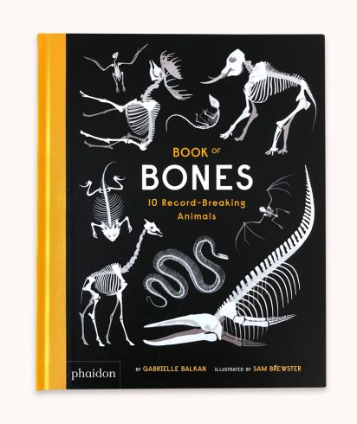





These are a few of the books we will be using to inspire our writing this year…

Slide 7
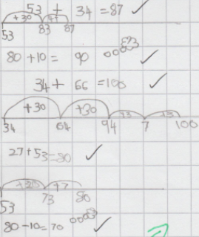
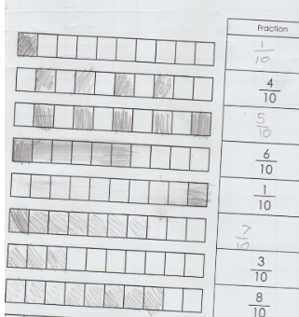
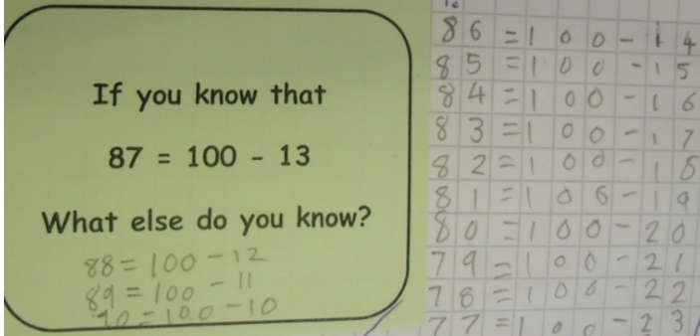
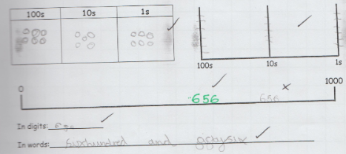
Maths
In Year 3 we will build on children’s understanding to work with numbers up to 1000.
We will practise addition and subtraction of 3-digit numbers using different methods.
We will solve problems, including missing number problems, using number facts, place value, and more complex addition and subtraction.
We will develop multiplication and division strategies, and learn the 3s,4s,8s,
We will continue to develop our learning of fractions, measurement and geometry too.

Slide 8
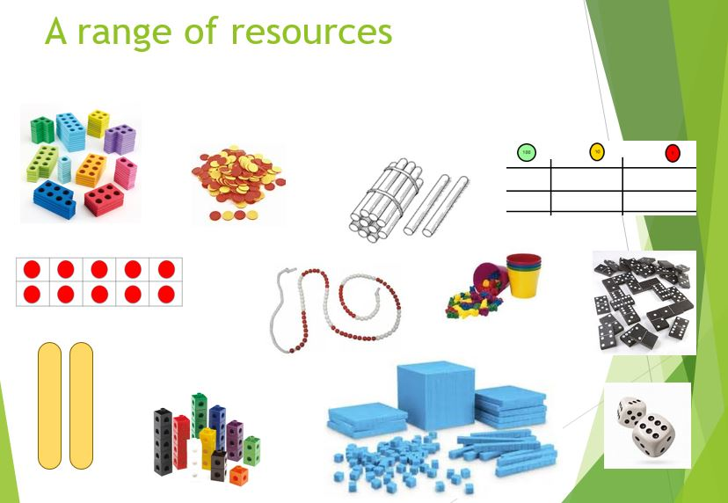
We will use a wide range of practical resources to support our work in Maths throughout the year.
This helps children to create a strong visual image of what the maths they are doing represents.

Slide 9
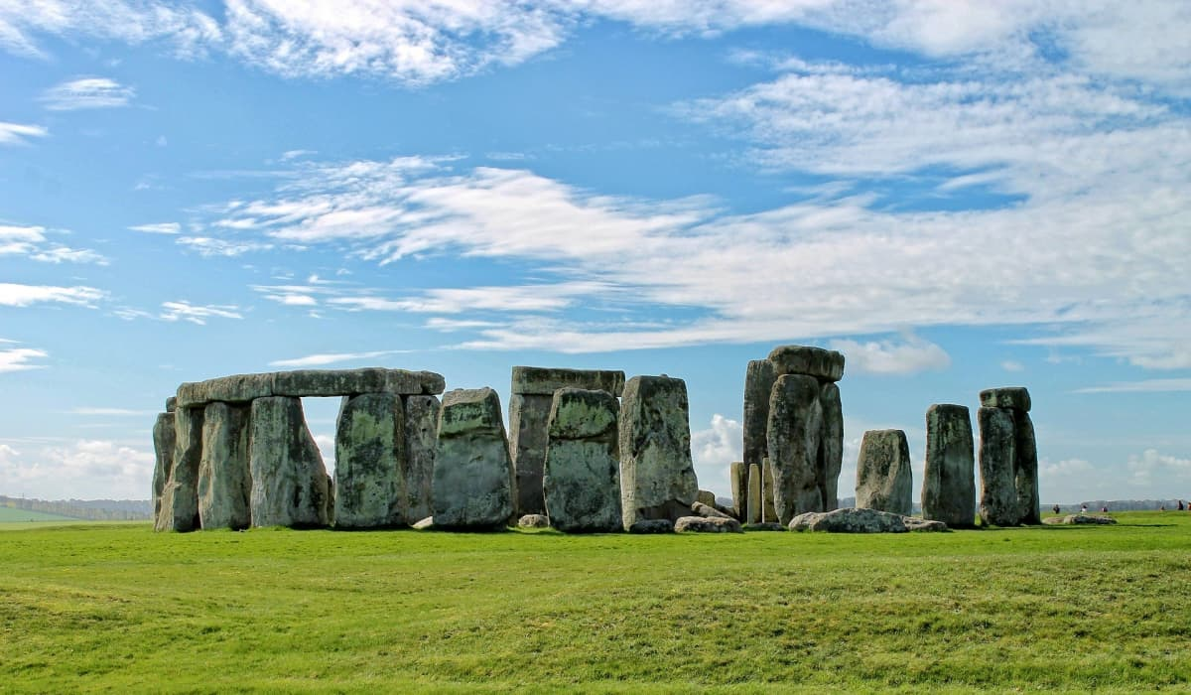

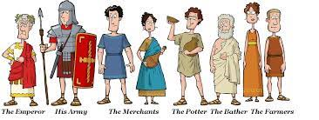
Wider curriculum
We have lots of interesting topics in store this year. Our learning will include:
London The Romans Stone Age
Year 3 will be taught Science, History, Geography, Music, Computing, PSHE, RE, Art, DT, French and PE each week.

Slide 10

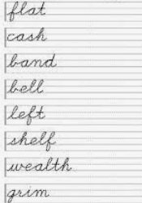


Homework
In Year 3 we try to keep homework to a minimum, but it really does make such a difference to your child’s progress if you support their learning at home where you can.
The expectations are:
Daily reading
(aim for 10-15 minutes a day)
Weekly spelling practice
(this will be on paper, with the additional option to play online games via Spelling Shed)
Maths facts practice
(via TTRS or maths shed)

Slide 11
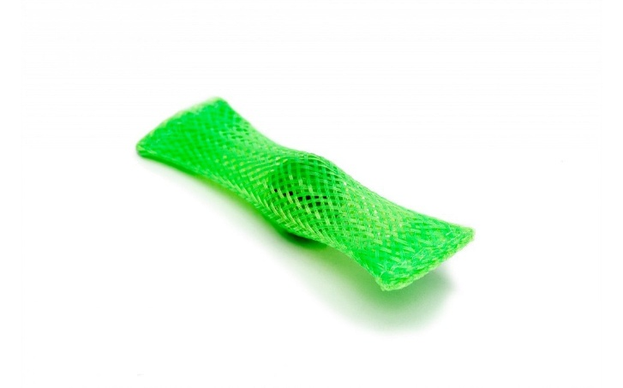
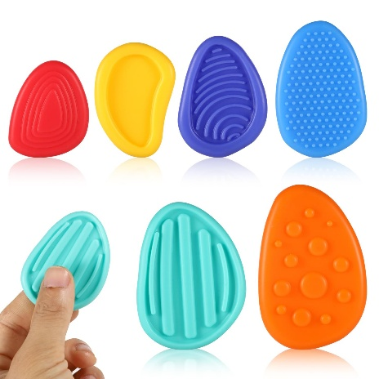
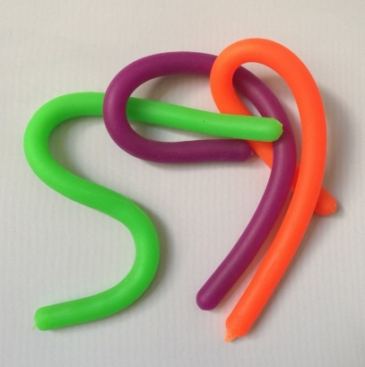
Fidget Tools
Some children are offered a ‘fidget tool’ in class to keep their hands busy while needing to focus for a longer period of listening
These will be given out by the school, as judged beneficial by the class teacher or SENDCO
Please do not send in a fidget toy from home, but if you suspect your child may benefit from one, you are welcome to drop us an email and we will monitor their needs and supply one if we feel it will have a beneficial effect. In practice, some children are more distracted by the fidget item itself than they are without it!
We have other tools in school that can support children, especially those with Special Educational Needs and Disabilities, which will be provided as necessary

Slide 12
Assessment
I can’t do it …YET!
We assess the children throughout the year taking into account their work in books, their contributions in class and their results in any assessment booklets.
There are two formal parents’ evenings in the Autumn and Spring terms; these are an opportunity to discuss progress, successes, areas for development and strategies moving forward alongside any pastoral areas. Your child’s individual targets will also be shared with you at these meetings.
There is an additional open evening for parents in the Summer term to visit your child’s current class teacher and meet the new teacher for the coming year.
Formal reports are produced during the Summer term and will give an overview of your child’s attainment in all subjects, a personal comment from the teacher and Headteacher, and targets for the year ahead.

Slide 13
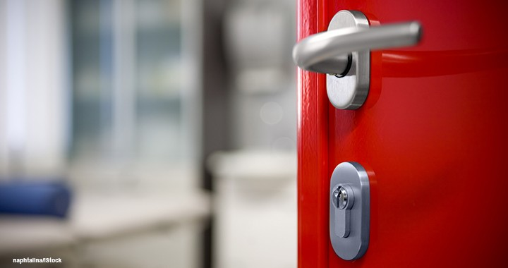
Communication
Please contact the class teacher first with any questions or worries.
For short questions/messages:
catch us at drop-off or pick-up times,
use the class email address year3@woottonpri.iow.sch.uk (checked 8:30 – 4:00),
pop a note into the reading diary for any non-urgent queries.
For longer conversations:
please arrange with the class teacher to meet after school or talk on the phone.
Our weekly newsletter includes an update from each teacher on what the children have been learning alongside important messages from the Headteacher.
The school facebook page also celebrates learning each week and often includes photographs of the children enjoying their lessons and educational visits.
Please keep the office updated with your contact details so you don’t miss any important messages ☺

Slide 14
We are looking forward to a fantastic year in
Hamilton Class ☺
Please feel free to ask any questions now or pop them on a post-it.
Thank you!

