Slide 1

Welcome to Year 4
Messi Class
This year our classes are named after people who have overcome challenges in their lives and become pioneers for inclusion.
Lionel Messi is the all-time football World Cup top scorer who has a medical condition called Growth Hormone Deficiency which impacted him as a child.

Slide 2
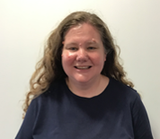
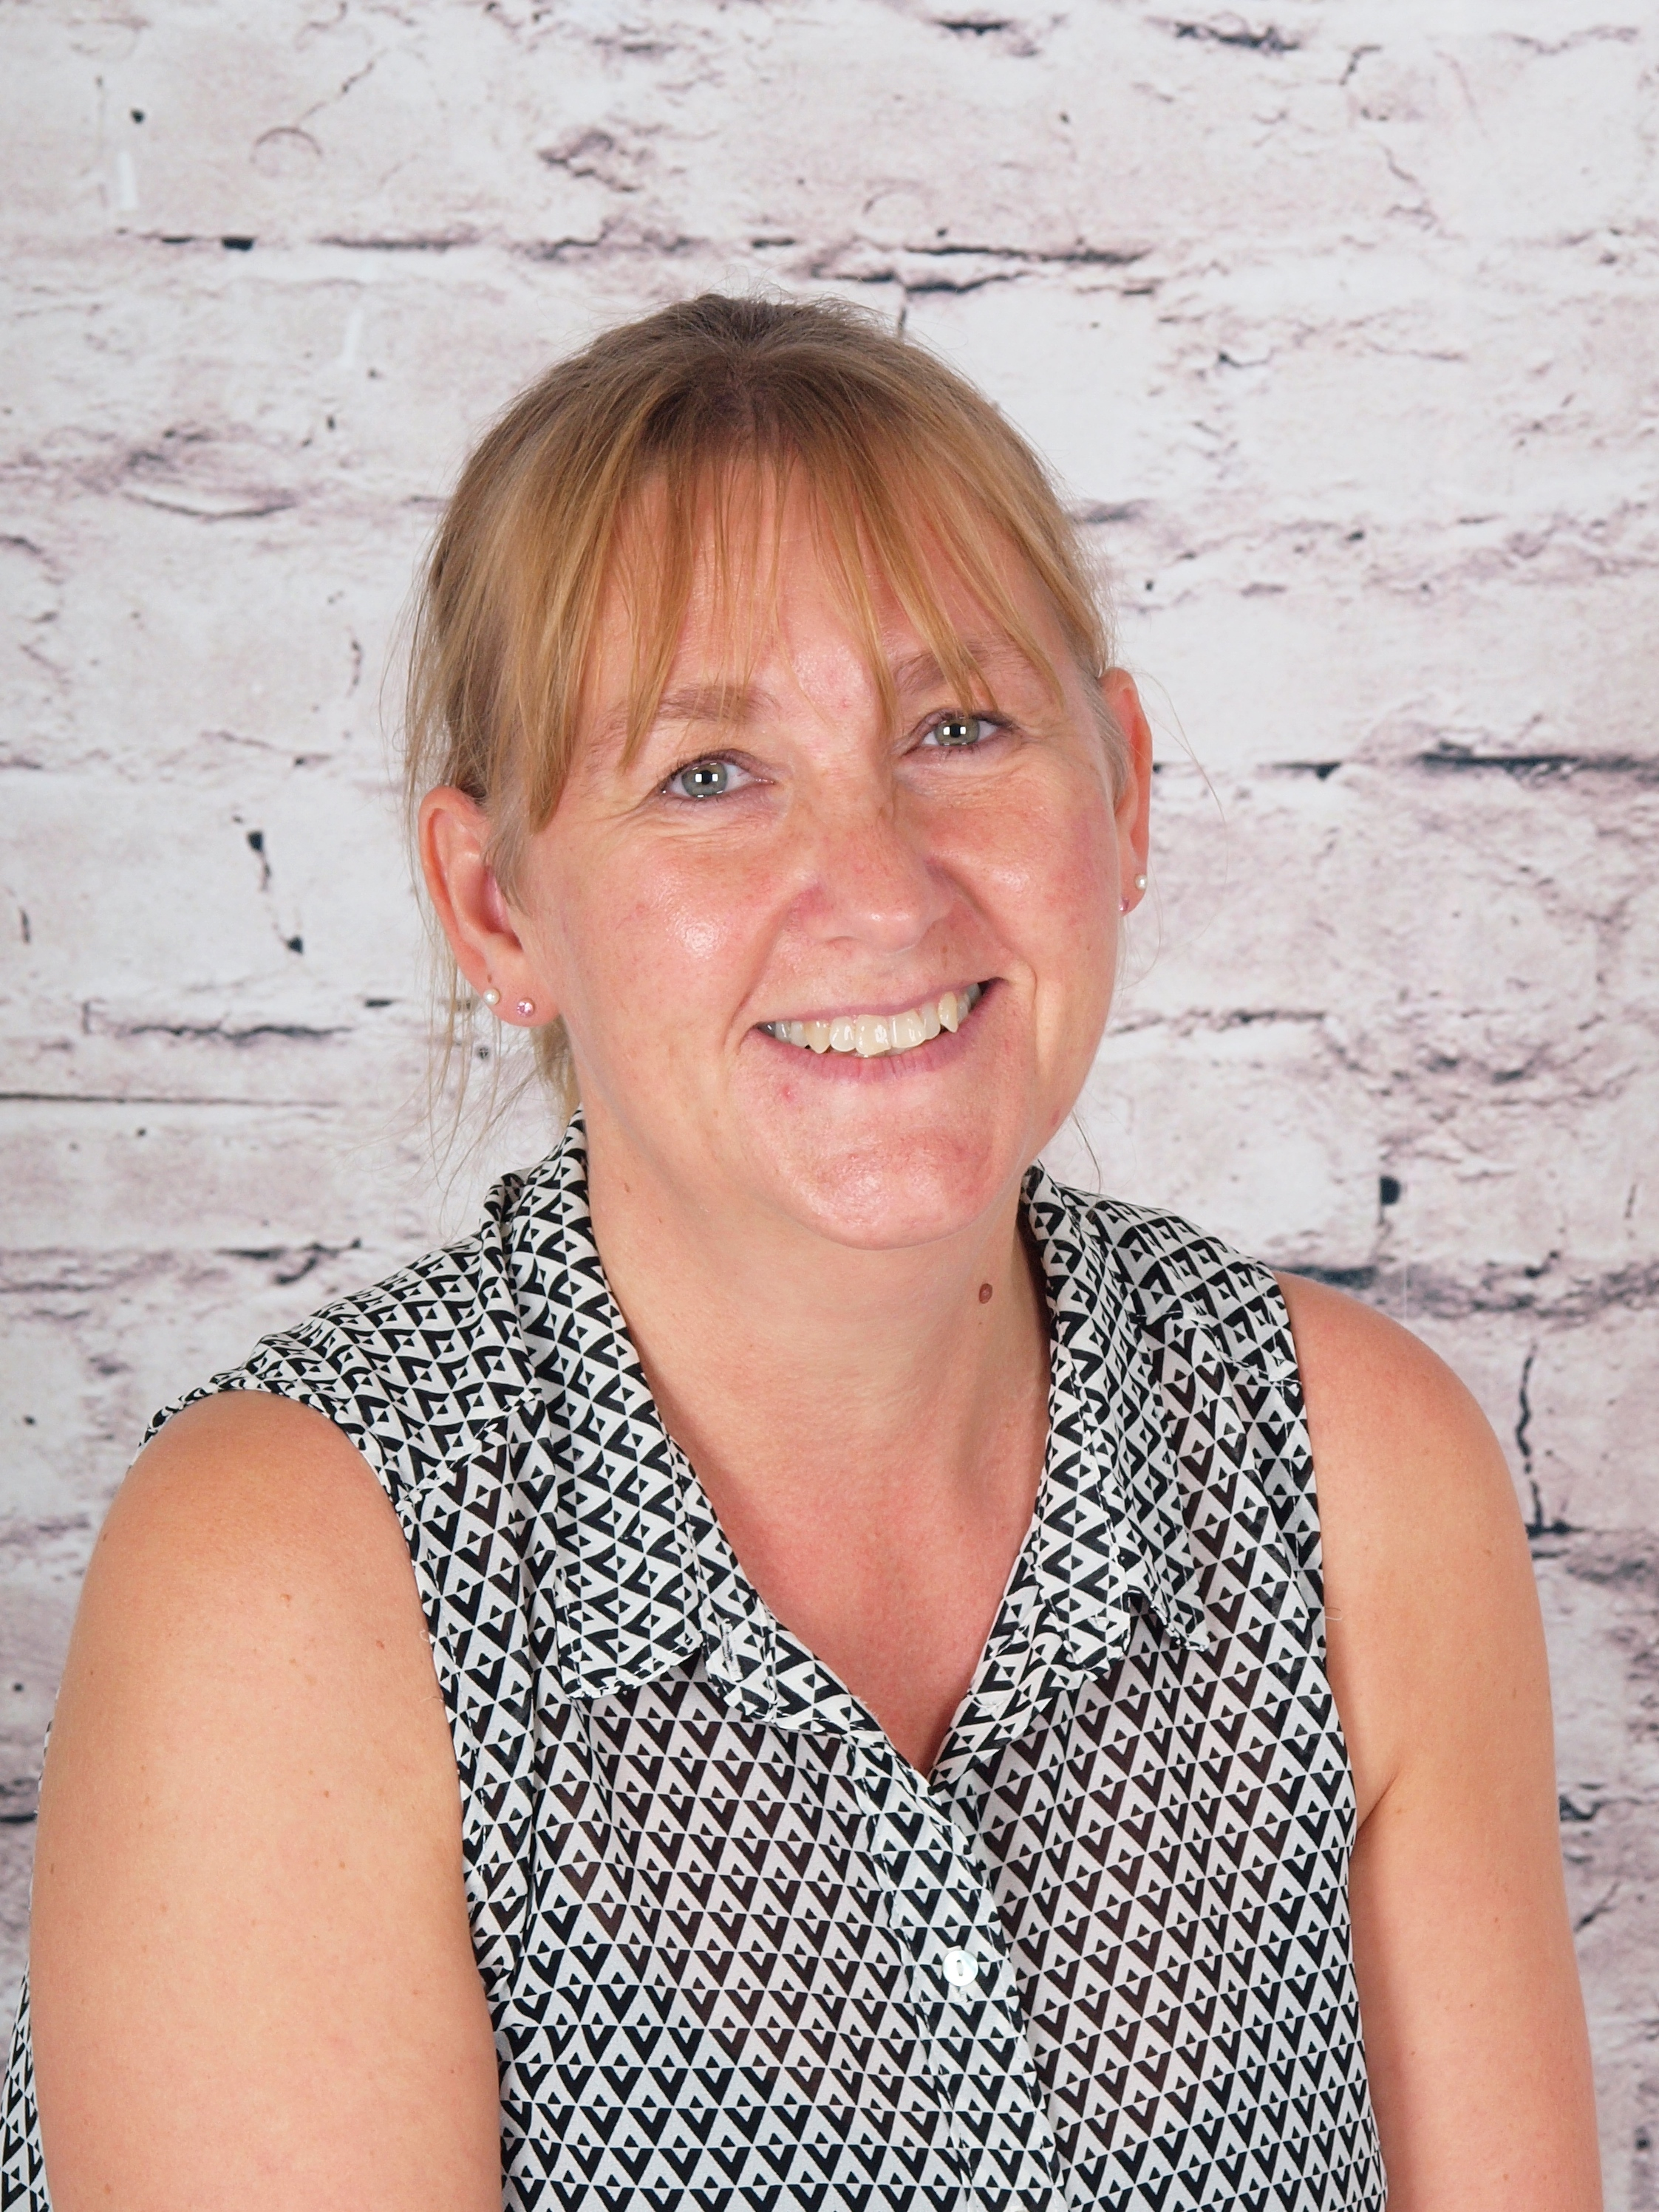
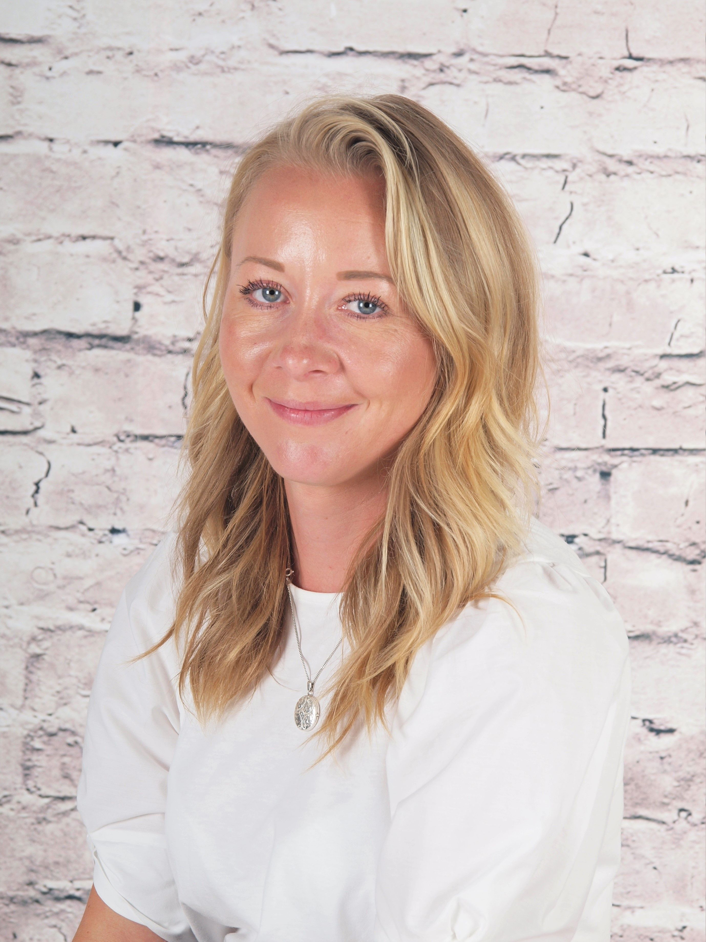
Who’s Who?
Teacher:
Mrs Hanson
Teaching assistants:
Mrs Dew
Miss Wood

Slide 3
Key times
Doors open at 8:30am until 8:40am
Your child will enter through the outside door of their classroom. It is useful to arrive in good time as we have learning activities to complete before the register.
KS2 break is at 10:35am
If your child brings their own snack this can be fruit, veggies, cheese, yogurt or plain rice cakes.
KS2 lunch is at 12:15pm
Children may order a school dinner or bring a packed lunch from home if they prefer.
School ends at 3:10pm - gates open at 3:05pm
Please wait outside the classroom for your child to be called. After Easter, Year 4 children may be given permission to walk home from school alone if you wish.
A range of clubs run from 3:10 - 4:10pm
These are allocated each half-term - keep an eye out for the booking letter ☺

Slide 4
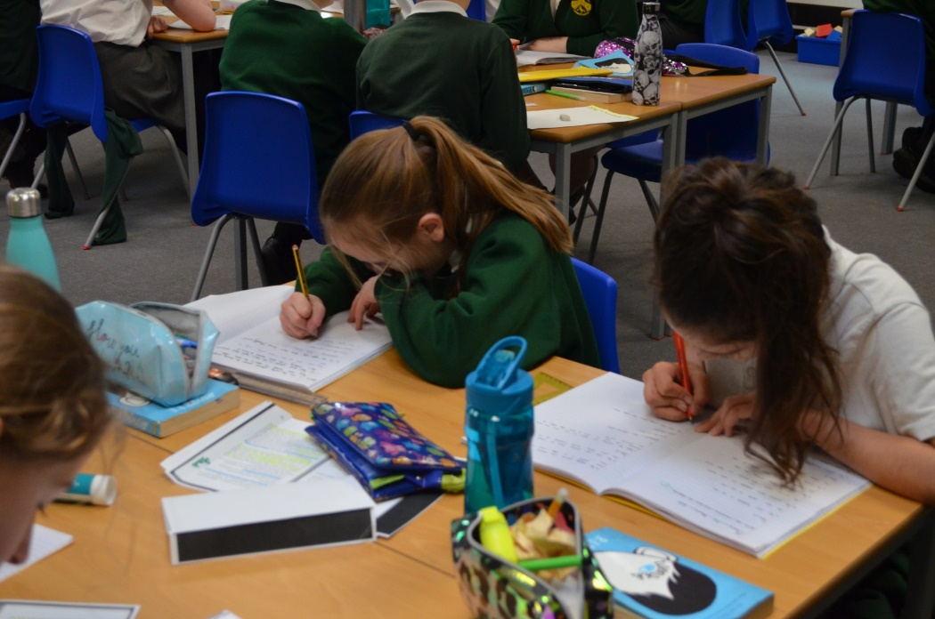
Developing independent learning skills
As pupils progress through primary school, they are encouraged to become more independent in their learning. Year 4 students are expected to take greater responsibility for their work, time management, and organizational skills. This prepares them for the increasing independence required as the progress onto Year 5, 6 and secondary school.

Slide 5

Reading
We will continue to develop reading enjoyment, stamina and fluency during year 4.
Within our school, we aim to encourage children to read for pleasure and have worked on our classroom reading areas to promote this. We have taken a quality over quantity approach, allowing children to choose their books easily.
Children can earn reading points and prizes for their home reading, and we hear every child read each week during guided reading.

Slide 6
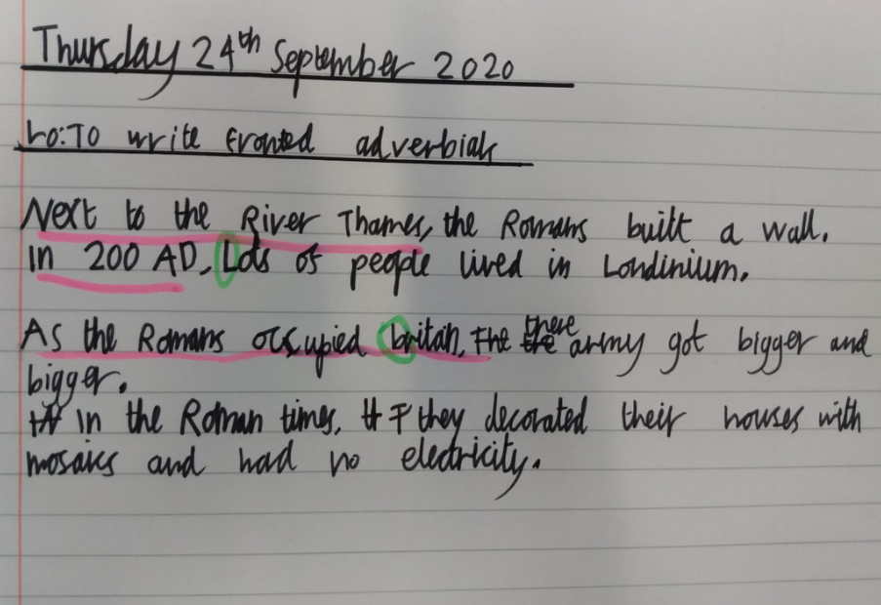
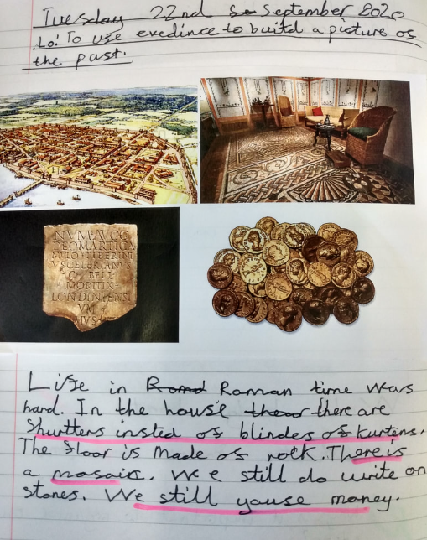
English
In Year 4 we will engage in a wide range of language activities, including reading, writing, speaking, and listening.
We will continue to build upon the literacy skills acquired in previous years, with a focus on developing a deeper understanding of language and literature. Year 4 will explore a variety of literary genres, analyze texts, and demonstrate their comprehension through discussion and written responses.
We will work on improving our writing skills, including narrative, persuasive, and informational writing, while also refining their grammar, punctuation, and vocabulary.
We will incorporate poetry, drama, and non-fiction texts, fostering a love for reading and a deeper appreciation of language as they progress through the academic year.

Slide 7





These are a few of the books we may be using to inspire our writing this year:

Slide 8
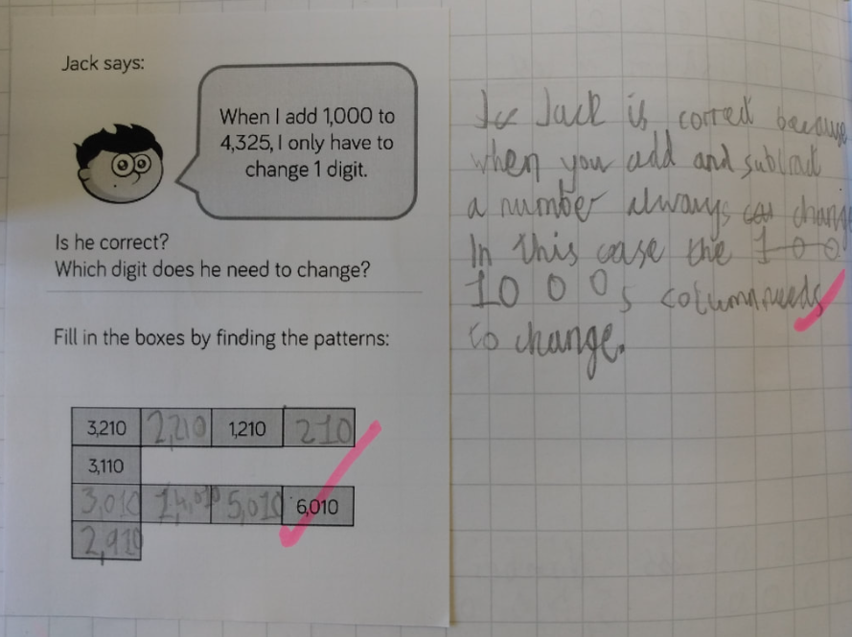

Maths
The multiplication tables check (MTC) is statutory for all year 4 pupils registered at state-funded maintained schools, special schools or academies (including free schools) in England.
The purpose of the MTC is to determine whether pupils can recall their times tables fluently, which is essential for future success in mathematics. It will help schools to identify pupils who have not yet mastered their times tables, so that additional support can be provided.
Encourage children to practice their times tables using Times Table Rock Stars :)

Slide 9
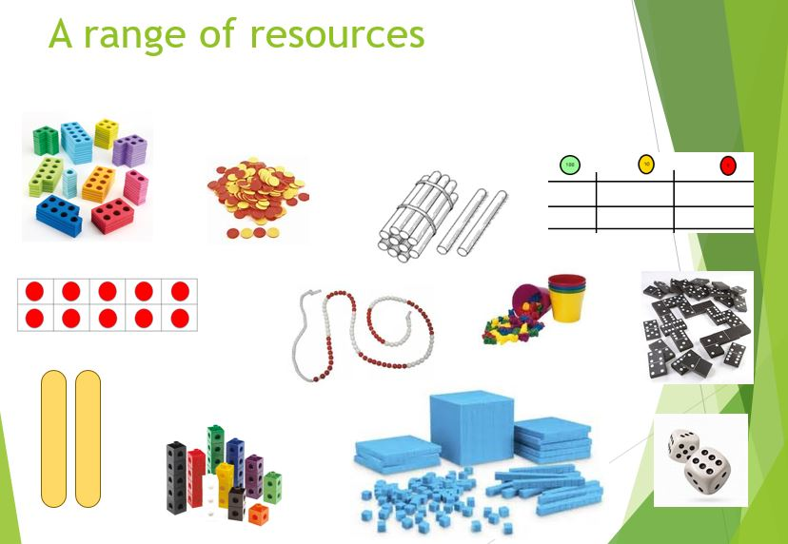
We will continue to use a wide range of practical resources to support our work in Maths throughout the year.
This helps children to create a strong visual image of what the Maths they are doing represents.

Slide 10
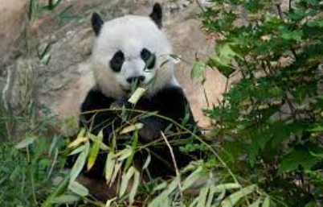

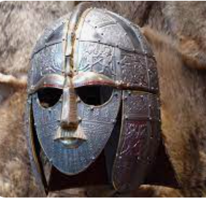
Wider curriculum
We have lots of interesting topics in store this year. Our learning will include:
The Anglo Saxons Living things and their Habitats
Year 4 will be taught Science, History, Geography, Music, Computing, PSHE, RE, Art, DT, French and PE each week.
Mountains and Earthquakes

Slide 11

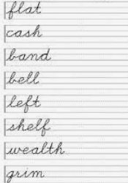

Homework
In Year 4 we encourage the children to take responsibility for their own homework, building good routines in preparation for Year 5.
The expectations are:
Daily reading
(aim for fifteen minutes a day, or a chapter of your book)
Weekly spelling practice
(this will be on paper, with the additional option to play online games via Spelling Shed)
Maths facts practice
(via Times Table Rockstars /MathsShed – 10 minutes a day)

Slide 12
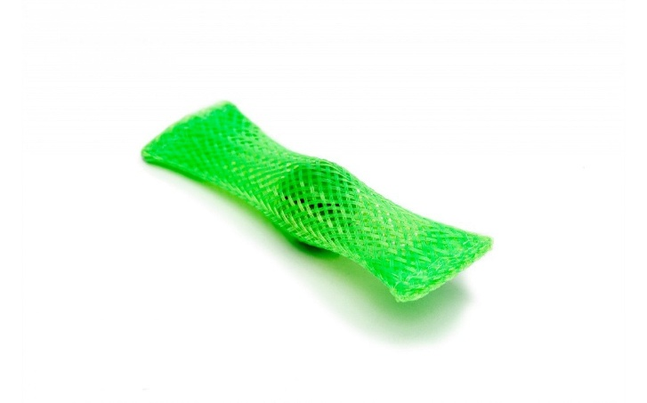

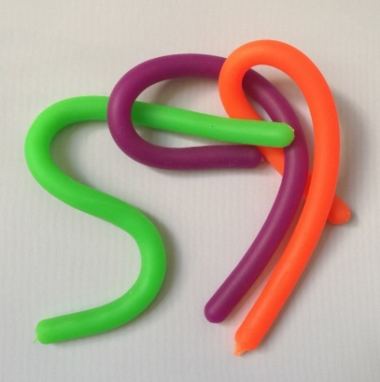
Fidget Tools
Some children are offered a ‘fidget tool’ in class to keep their hands busy while needing to focus for a longer period of listening
These will be given out by the school, as judged beneficial by the class teacher or SENDCO
Please do not send in a fidget toy from home, but if you suspect your child may benefit from one, you are welcome to drop us an email and we will monitor their needs and supply one if we feel it will have a beneficial effect. In practice, some children are more distracted by the fidget item itself than they are without it!
We have other tools in school that can support children, especially those with Special Educational Needs and Disabilities, which will be provided as necessary

Slide 13
Assessment
We assess the children throughout the year taking into account their work in books, their contributions in class and their results in any formal assessment tests.
There are two formal parents’ evenings in the Autumn and Spring terms; these are an opportunity to discuss progress, successes, areas for development and strategies moving forward alongside any pastoral areas. Your child’s individual targets will also be shared with you at these meetings.
There is an additional open evening for parents in the Summer term to visit your child’s current class teacher and meet the new teacher for the coming year.
Formal reports are produced during the Summer term and will give an overview of your child’s attainment in all subjects, a personal comment from the teacher and Headteacher, and targets for the year ahead.
I can’t do it …YET!

Slide 14

Communication
Please contact the class teacher first with any questions or worries.
For short questions / messages:
catch us at drop-off or pick-up times,
use the class email address year4@woottonpri.iow.sch.uk (checked 8:30 - 4:00),
pop a note into the reading diary for any non-urgent queries.
For longer conversations:
please arrange with the class teacher to meet after school or talk on the phone.
Our weekly newsletter includes an update from each teacher on what the children have been learning alongside important messages from the Headteacher.
The school Facebook page also celebrates learning each week and often includes photographs of the children enjoying their lessons and educational visits.
Please keep the office updated with your contact details so you don’t miss any important messages ☺

Slide 15
We are looking forward to a great year in
Messi Class ☺
Please feel free to ask any questions now, pop them on a post-it, or drop me an email: year4@woottonpri.iow.sch.uk
Thank you!

