Slide 1


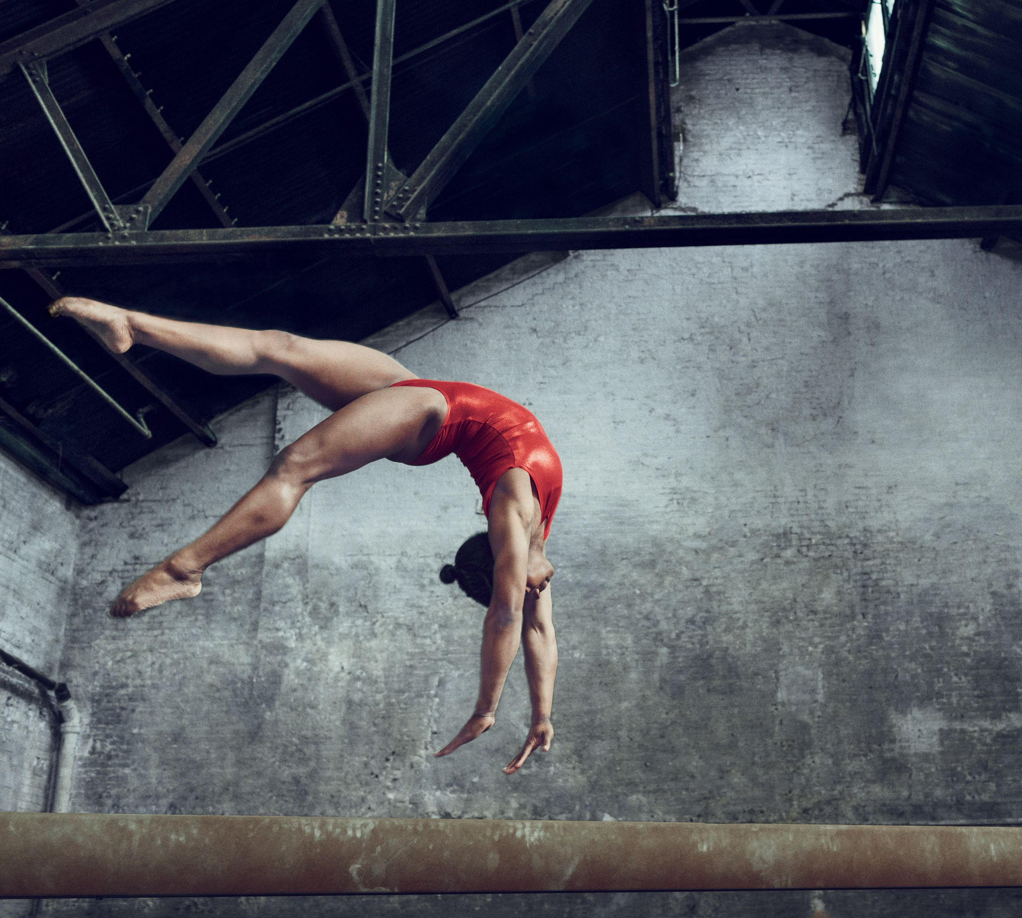
Welcome to Year 5
Biles Class
This year our classes are named after people who have overcome challenges in their lives and become pioneers for inclusion. Simone Biles is widely regarded as the most dominant gymnast in sports history, with a total of 41 Olympic and World Championship medals. She has ADHD and encourages others to see ADHD as a unique difference, and sometimes superpower!

Slide 2
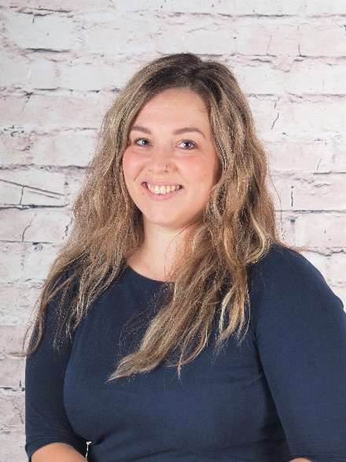
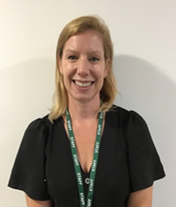
Who’s Who
Teacher:
Ms. White
Teaching assistants:
Miss Jukes

Slide 3
Key times
Doors open at 8:30am until 8:40am
Your child will enter through the outside door of their classroom. It is useful to arrive in good time as we have learning activities to complete before the register.
KS2 break is at 10:35am
If your child brings their own snack this can be fruit, veggies, cheese, yogurt, or plain rice cakes.
KS2 lunch is at 12:15pm
Children may order a school dinner or bring a packed lunch from home if they prefer.
School ends at 3:10pm – gates open at 3:05pm
If your child walks home or to the gate at the bottom they will be released to meet you. Other parents may wait at the top of the drive to meet their children.
A range of clubs run from 3:10 – 4:10pm
These are allocated each half-term – keep an eye out for the booking letter ☺

Slide 4
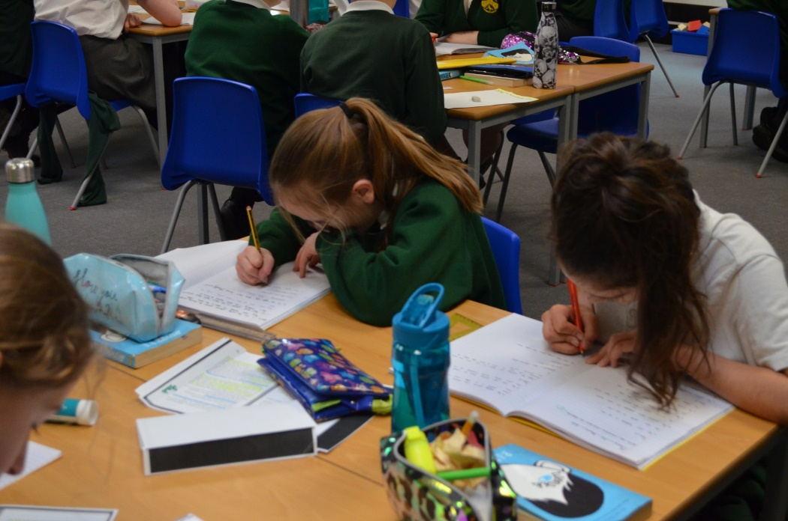
Developing independent learning skills
Year 5 is an important year for developing independent learning skills and ensuring all children are ready for the challenges of Year 6 and secondary school.
Throughout the year you will notice this and should encourage it; help your child to learn to organise their time and belongings and take responsibility for their own learning.

Slide 5
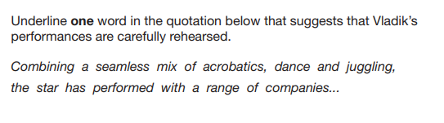
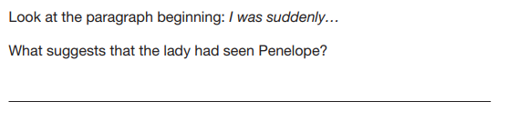
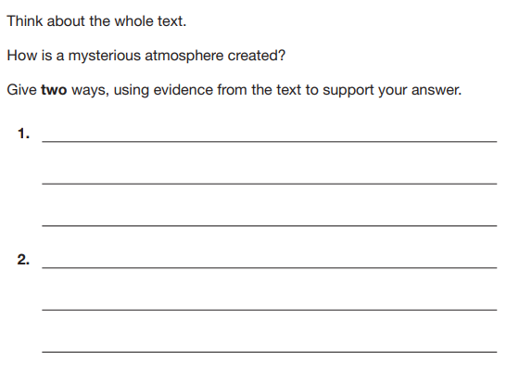
Reading
We will continue to develop reading enjoyment, stamina and fluency during year 5. The children will tackle longer and more complex texts in class and in their home reading.
The focus of reading lessons will begin to shift towards more in-depth written responses, and children will develop their skills to explain answers in detail, using evidence from different places in the text to support their answers.
They will also focus on how authors have used language and grammatical structures for effect, explaining why particular choices may have been made.
We will begin to compare authorial voice across a range of texts by the same author, contrasted with different styles of writing by other novelists.

Slide 6
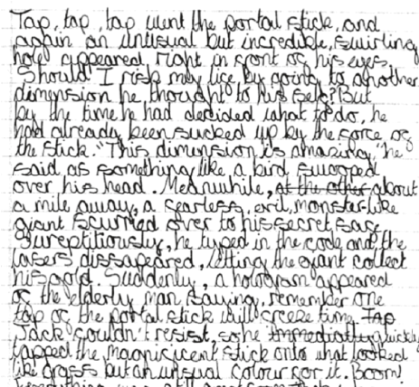
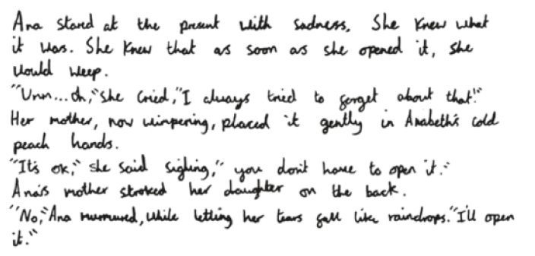
Writing
In Year 5 we will continue to build on the work from the previous year around technical accuracy and composition for effect.
The children will explore different purposes for writing and the grammatical structures and languages best suited to these. They will be asked to write at more length, and with more control over the order of content and paragraph structure of their work.
They will also learn to use a wider range of sentence structures and punctuation to achieve different effects.
We will expect the children to check their own work for spelling, punctuation and sentence structure automatically, and begin to edit for effect more independently.

Slide 7
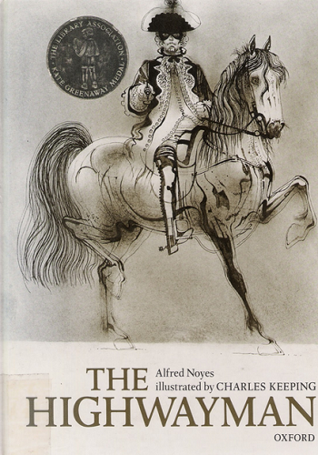





These are a few of the books we may be using to inspire our writing this year
Pandora Discovered (film)

Slide 8


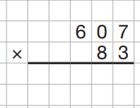
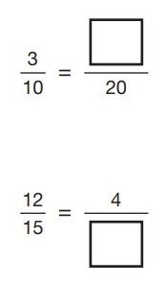
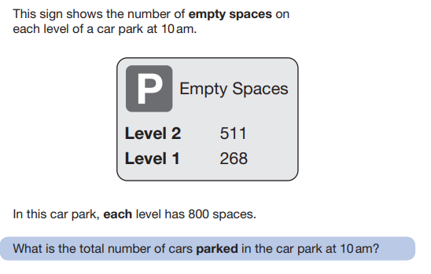
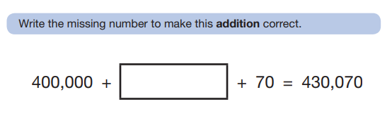
Maths
In Year 5 we will build on children’s understanding to work with numbers up to 100,000 and beyond.
We will secure efficient methods for addition, subtraction, multiplication and division, considering when each method is the most suitable.
The main focus of the year will be to develop understanding in fractions and decimals to be able to confidently convert and calculate with and between fractions and decimals and also begin to calculate percentages.
The class will also deepen their learning in measurement and geometry to include further work on converting units of measurement and calculating angles.

Slide 9
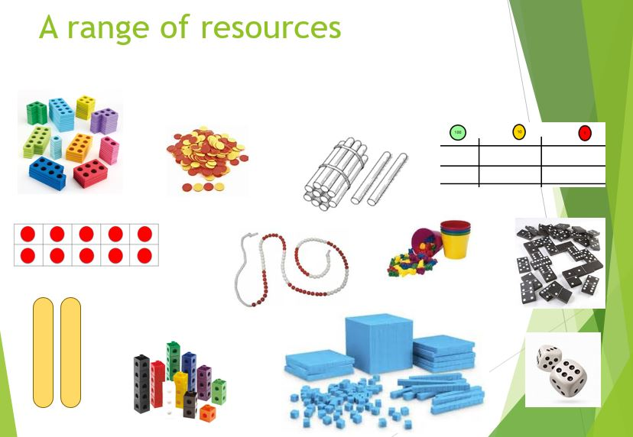
We will continue to use a wide range of practical resources to support our work in Maths throughout the year.
This helps children to create a strong visual image of what the maths they are doing represents.

Slide 10
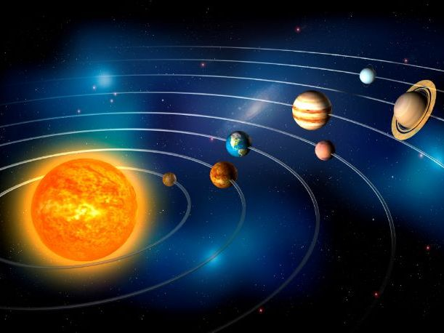
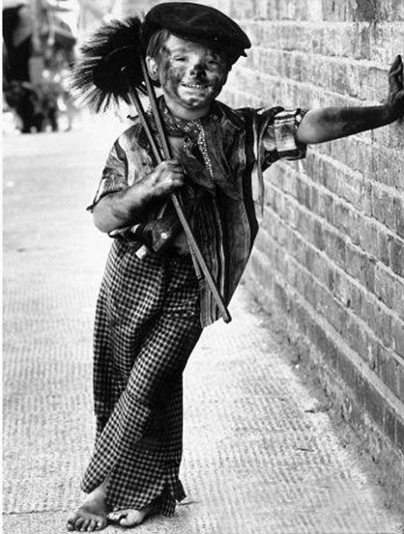
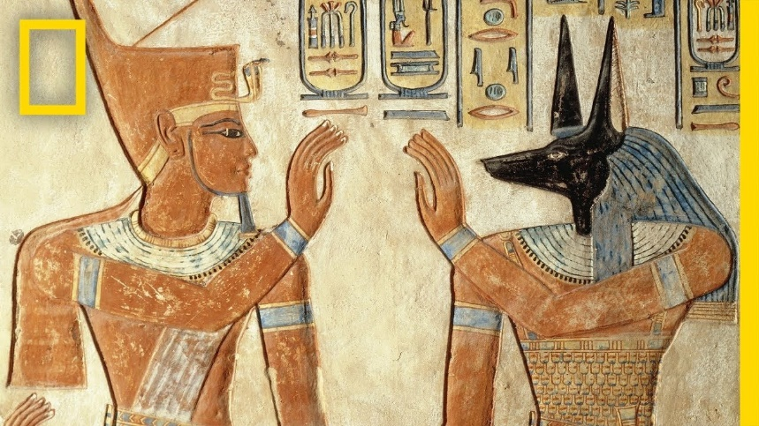
Wider curriculum
We have lots of interesting topics in store this year. Our learning will include:
Ancient Egypt Earth and Space
Year 5 will be taught Science, History, Geography, Music, Computing, PSHE, RE, Art, DT, French and PE each week.
Victorian children

Slide 11
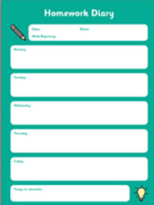

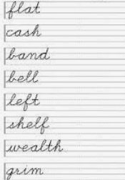


Homework
In Year 5 we encourage the children to take responsibility for their own homework, building good routines in preparation for Year 6 and secondary school.
The expectations are:
Daily reading
(aim for fifteen minutes a day, or a chapter of your book)
Weekly spelling practice
(this will be on paper, with the additional option to play online games via Spelling Shed)
Maths facts practice
(via Times Table Rockstars – 10 minutes a day)
During the year, Maths homework will adjust to
include specific work linked to class learning instead
of times table practice

Slide 12
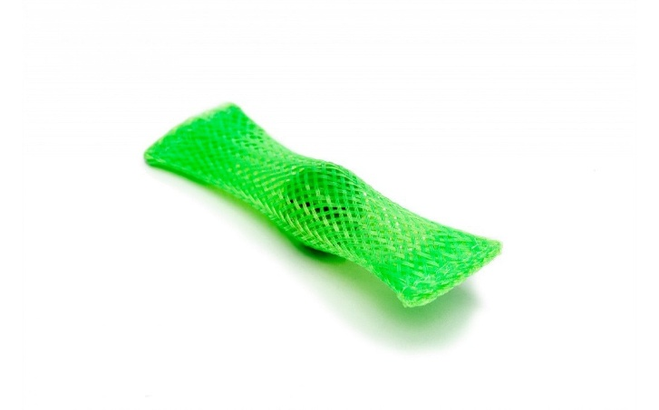
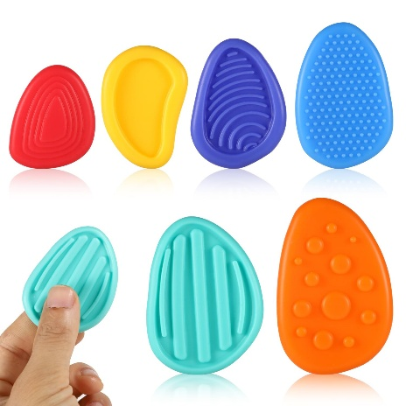
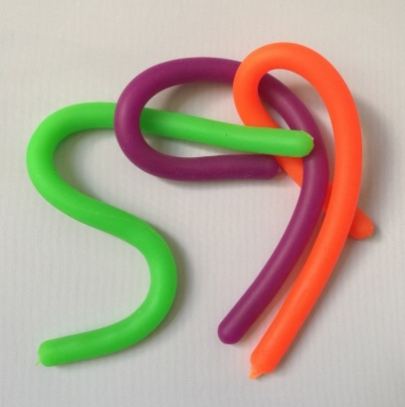
Fidget Tools
Some children are offered a ‘fidget tool’ in class to keep their hands busy while needing to focus for a longer period of listening
These will be given out by the school, as judged beneficial by the class teacher or SENDCO
Please do not send in a fidget toy from home, but if you suspect your child may benefit from one, you are welcome to drop us an email and we will monitor their needs and supply one if we feel it will have a beneficial effect. In practice, some children are more distracted by the fidget item itself than they are without it!
We have other tools in school that can support children, especially those with Special Educational Needs and Disabilities, which will be provided as necessary

Slide 13
Assessment
We assess the children throughout the year taking into account their work in books, their contributions in class and their results in any formal assessment tests.
There are two formal parents’ evenings in the Autumn and Spring terms; these are an opportunity to discuss progress, successes, areas for development and strategies moving forward alongside any pastoral areas. Your child’s individual targets will also be shared with you at these meetings.
There is an additional open evening for parents in the Summer term to visit your child’s current class teacher and meet the new teacher for the coming year.
Formal reports are produced during the Summer term and will give an overview of your child’s attainment in all subjects, a personal comment from the teacher and Headteacher, and targets for the year ahead.
I can’t do it …YET!

Slide 14
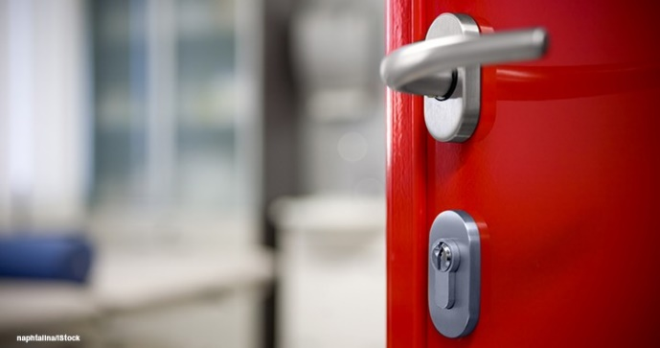
Communication
Please contact the class teacher first with any questions or worries.
For short questions / messages:
catch us at drop-off or pick-up times,
use the class email address year5@woottonpri.iow.sch.uk (checked 8:30 – 4:00),
pop a note into the reading diary for any non-urgent queries.
For longer conversations:
please arrange with the class teacher to meet after school or talk on the phone.
Our weekly newsletter includes an update from each teacher on what the children have been learning alongside important messages from the Headteacher.
The school facebook page also celebrates learning each week and often includes photographs of the children enjoying their lessons and educational visits.
Please keep the office updated with your contact details so you don’t miss any important messages ☺

Slide 15
We are looking forward to a great year in
Biles Class ☺
Please feel free to ask any questions now, pop them on a post-it, or drop me an email
year5@woottonpri.iow.sch.uk
Thank you!

