Slide 1
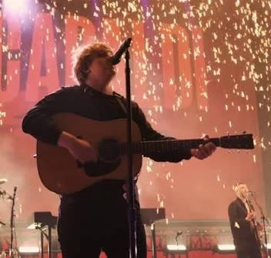
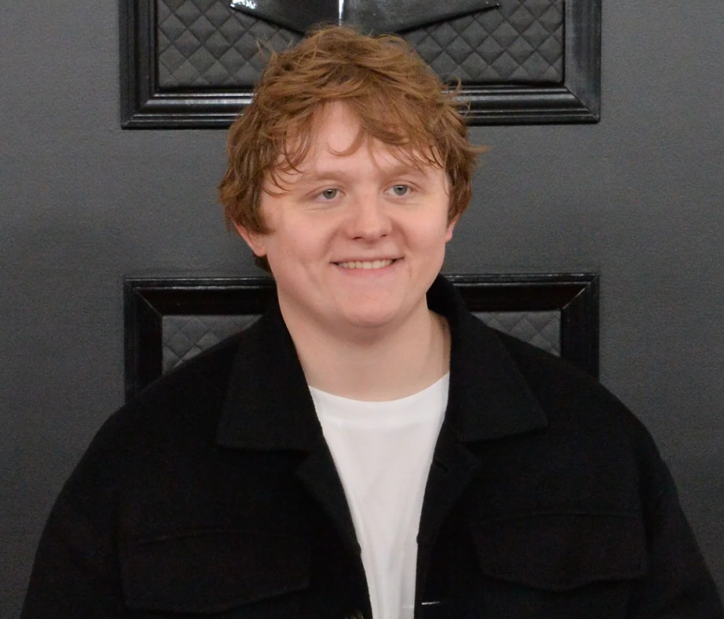
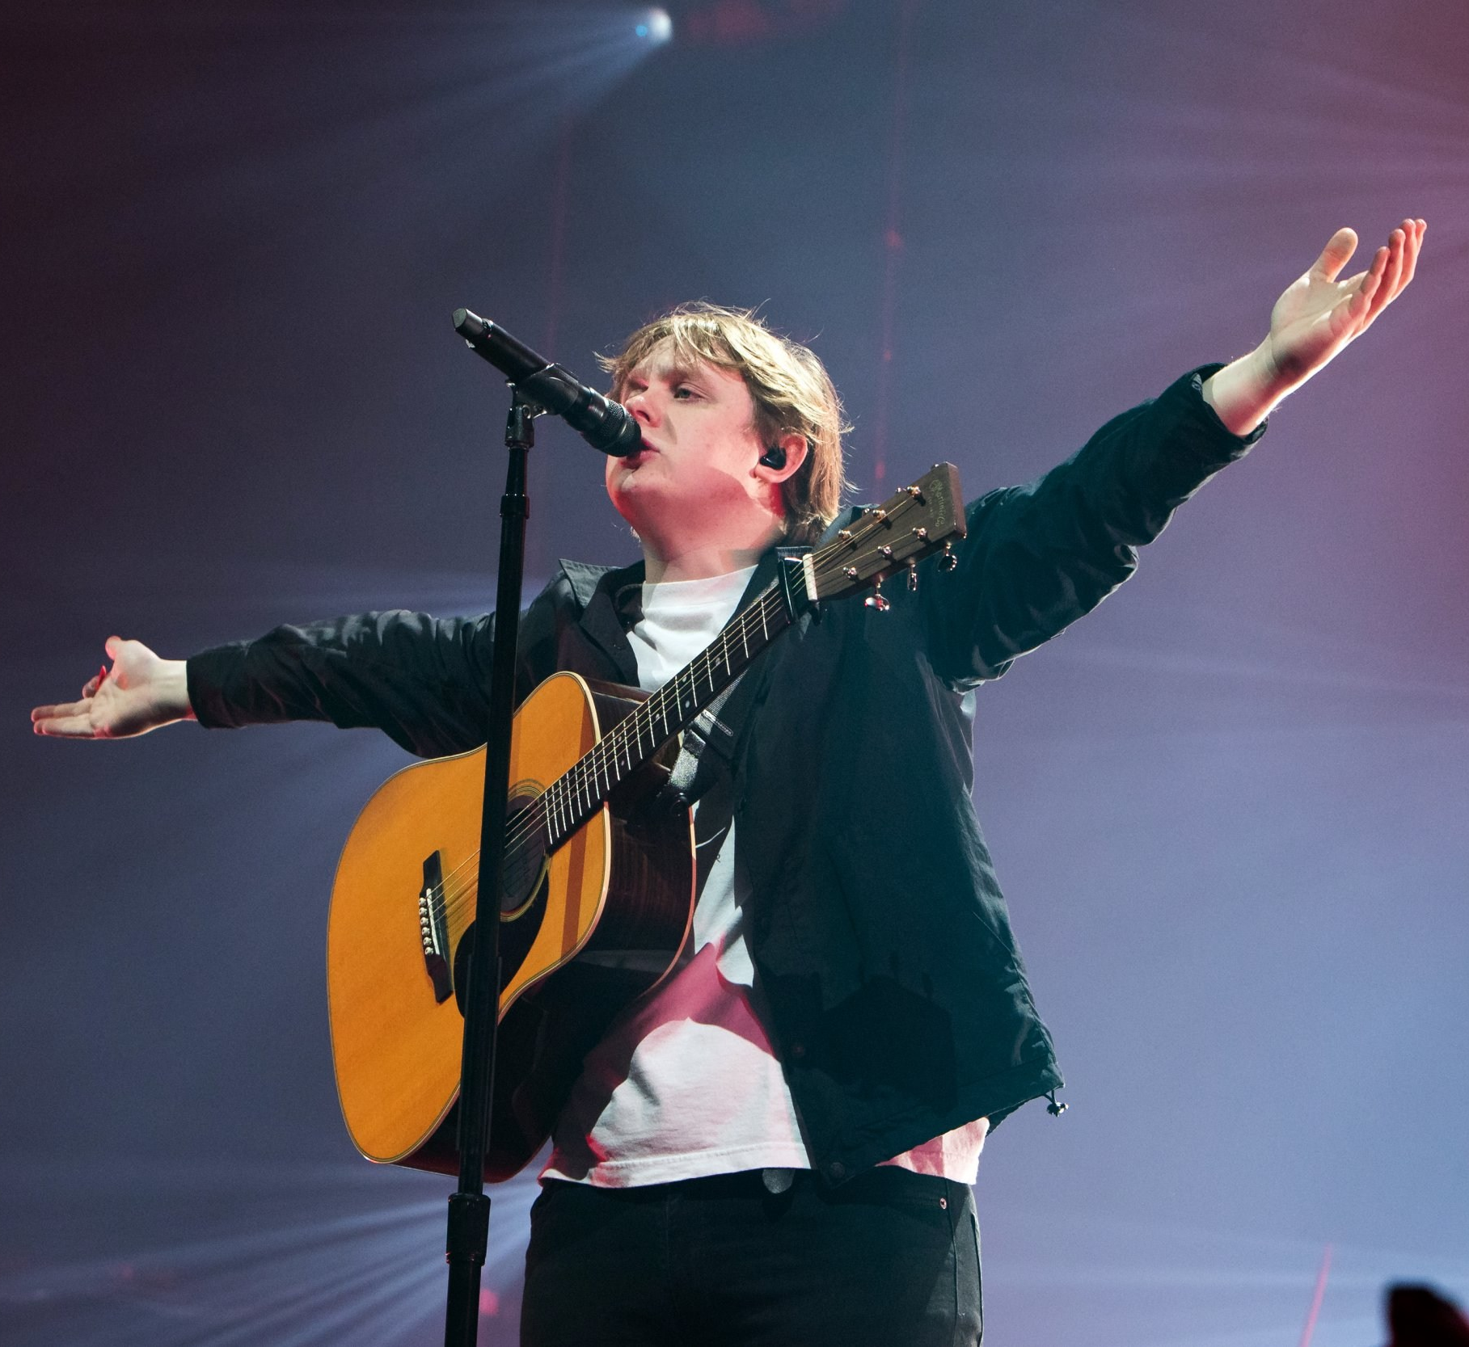
Welcome to Year 6
Capaldi Class
This year our classes are named after people who have overcome challenges in their lives and become pioneers for inclusion. Lewis Capaldi is a chart-topping singer-songwriter across the globe who has Tourette’s syndrome.

Slide 2
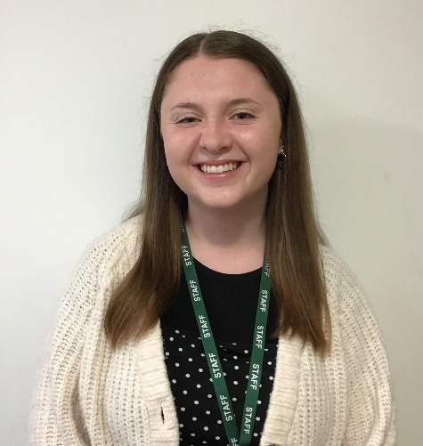
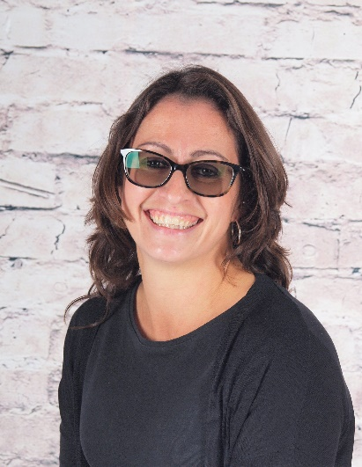
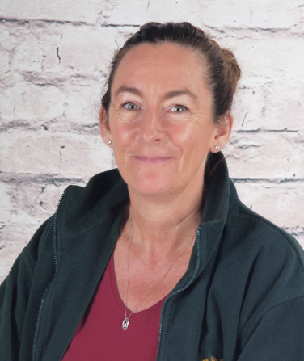
Who’s Who
Teacher:
Miss Adams
Teaching assistants:
Mrs Menzies
Mrs Gilbert

Slide 3
Key times
Doors open at 8:30am – 8:40am
Your child will enter through the back entrance next to Reception/Year Three.
KS2 break is at 10:35am
If your child brings their own snack this can be fruit, veggies, cheese, yogurt, or plain rice cakes.
KS2 lunch is at 12:15pm
Children may order a school dinner or bring a packed lunch from home if they prefer.
School ends at 3:10pm – gates open at 3:05pm
If your child walks home or to the gate at the bottom they will be released to meet you. Other parents may wait at the top of the drive to meet their children.
A range of clubs run from 3:10 – 4:10pm
These are allocated each half-term – keep an eye out for the booking letter

Slide 4
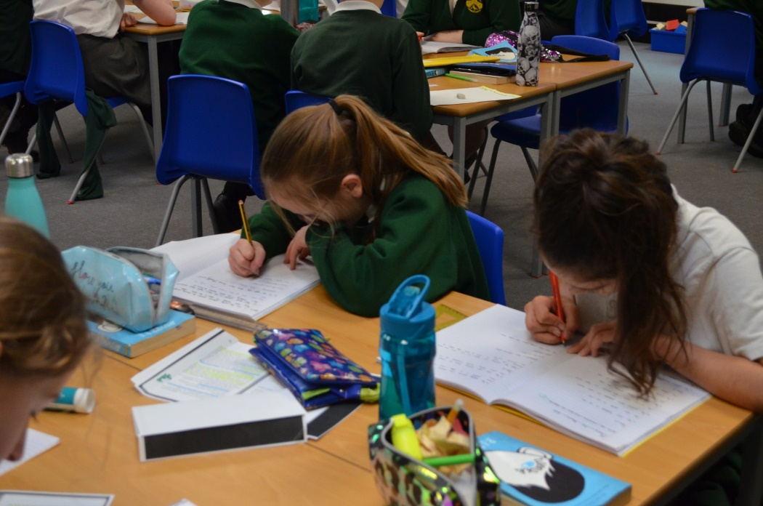
Developing independent learning skills
Year 6 is an important year for developing independent learning skills and ensuring all children are ready for the challenges of secondary school.
Throughout the year you will notice this and should encourage it; help your child to learn to organise their time and belongings, and take responsibility for their own learning.
They may bring their own pencil cases to school, but equipment will be available for any who choose not to.

Slide 5
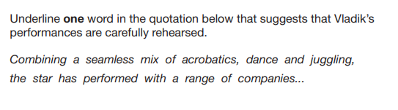
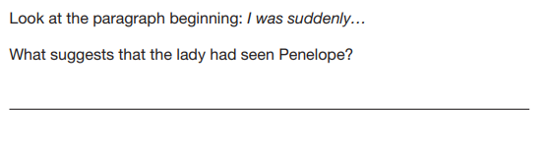
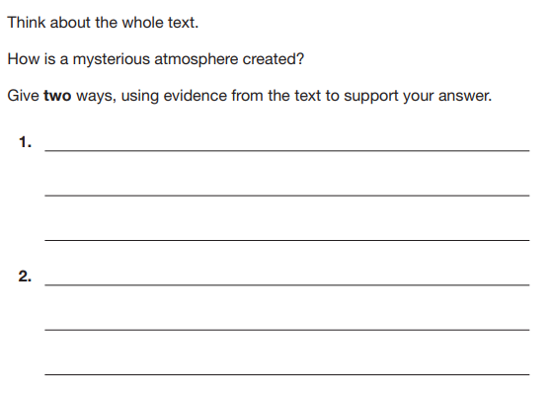
Reading
We will continue to develop reading enjoyment, stamina and fluency during year 6. The children will tackle longer and more complex texts in class and in their home reading.
Reading lessons will involve more in-depth written responses, and children will develop their skills to explain answers in detail, using evidence from different places in the text to support their answers.
They will also focus on how authors have used language and grammatical structures for effect, explaining why particular choices may have been made.
We will compare authorial voice across a range of texts by the same author, contrasted with different styles of writing by other novelists.

Slide 6
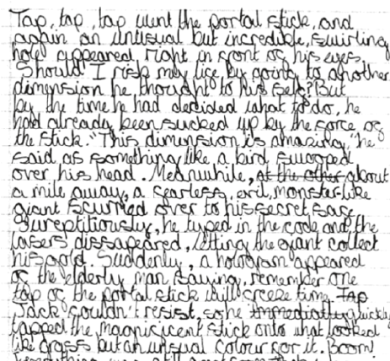
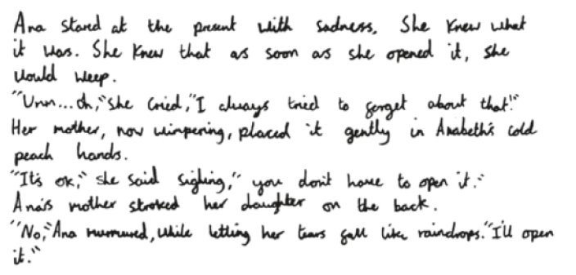
Writing
In Year 6 we will draw together the work from the previous years and apply this, refining technical accuracy and composition for effect.
The children will explore different purposes for writing and the grammatical structures and languages best suited to these. They will be expected to write at more length, and with more control over the order of content and paragraph structure of their work.
They will also revise a wide range of sentence structures and punctuation to achieve different effects.
We will expect the children to check their own work for spelling, punctuation and sentence structure automatically, and begin to edit for effect more independently.

Slide 7



These are a few of the books we will be using to inspire our writing this year

Slide 8


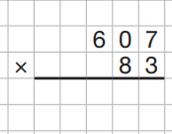
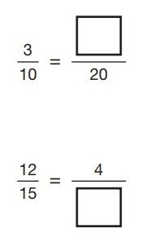
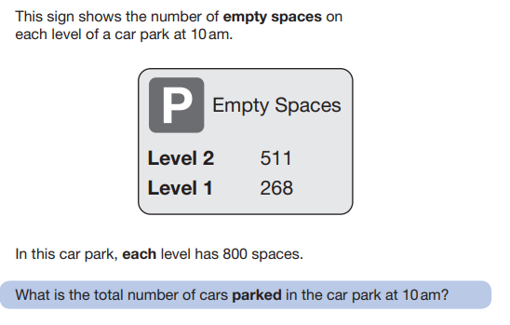
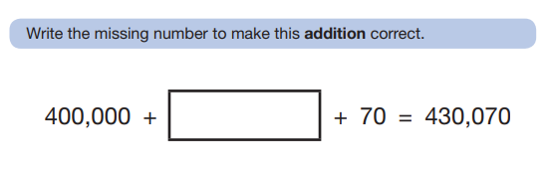
Maths
In Year 6 we will build on children’s understanding to work with numbers up to 100,000 and beyond.
We will review efficient methods for addition, subtraction, multiplication and division, considering when each method is the most suitable.
The main focus of the year will be to secure understanding in fractions and decimals to be able to confidently convert and calculate with and between fractions and decimals and also begin to calculate percentages.
The year will begin with a focus on arithmetic (to make sure the children have secure methods for all four operations, and are able to calculate with FDP) before we adjust our focus to deeper reasoning. There will be reasoning tasks throughout the year, but the start of the autumn term is heavily weighted towards arithmetic.

Slide 9
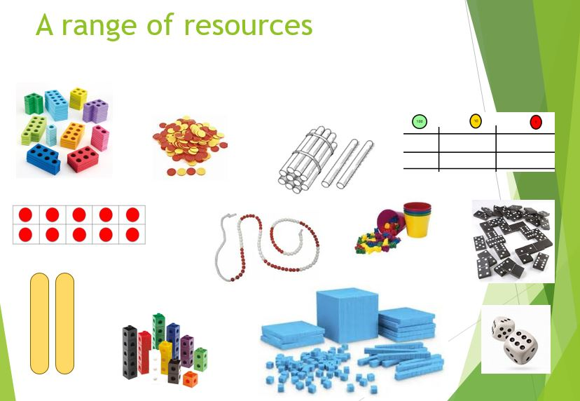
We will continue to use some practical resources to support our work in Maths throughout the year, along with many different models (diagrams).
This helps children to create a strong visual image of what the maths they are doing represents.

Slide 10
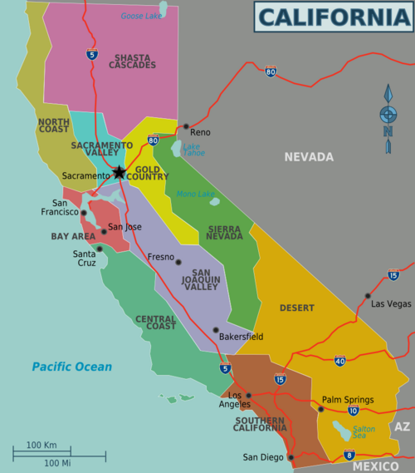
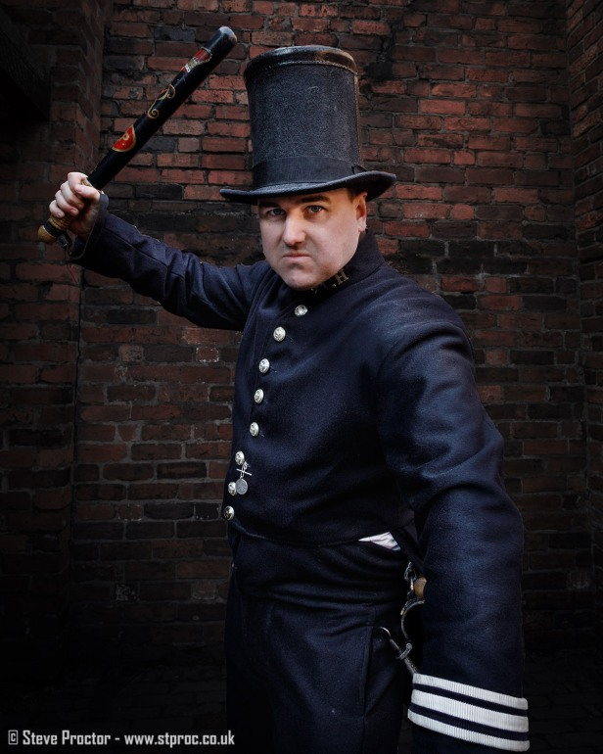
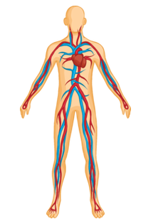
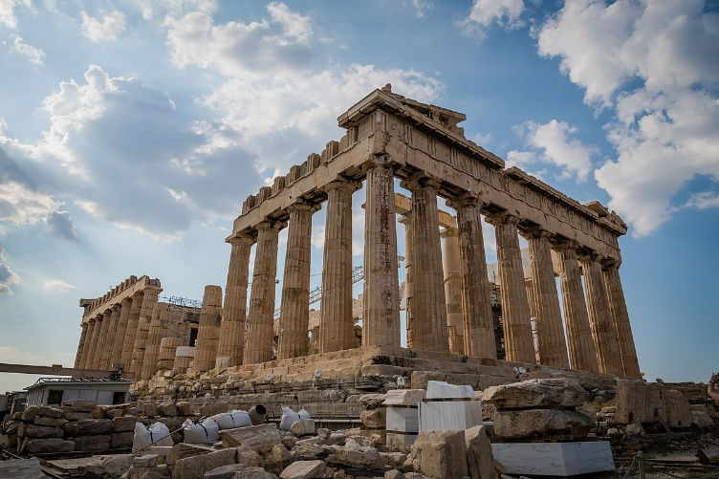
Wider curriculum
We have lots of interesting topics in store this year. Our learning will include:
Ancient Greece California Crime & Punishment Through Time Circulation
Year 6 will be taught Science, History, Geography, Music, Computing, PSHE, RE, Art, DT, French and PE each week.

Slide 11

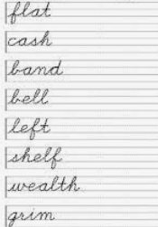

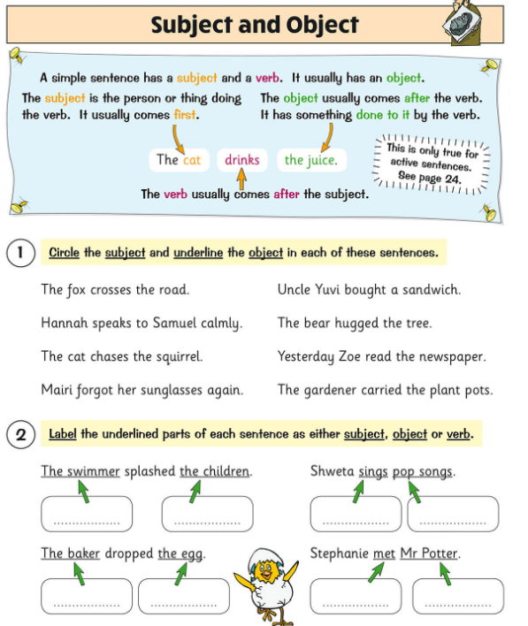

Homework
In Year 6 we encourage the children to take responsibility for their own homework, building good routines in preparation for secondary school.
The expectations are:
Daily reading (regular reading is so important!)
(aim for fifteen minutes a day, or a chapter of your book)
Weekly spelling practice
(this will be on paper, with the additional option to play online games via Spelling Shed)
Maths facts practice
(via Times Table Rockstars / Maths Shed – 10 minutes a day)
Grammar revision
(worksheet-based)
Maths revision
(worksheet-based)

Slide 12
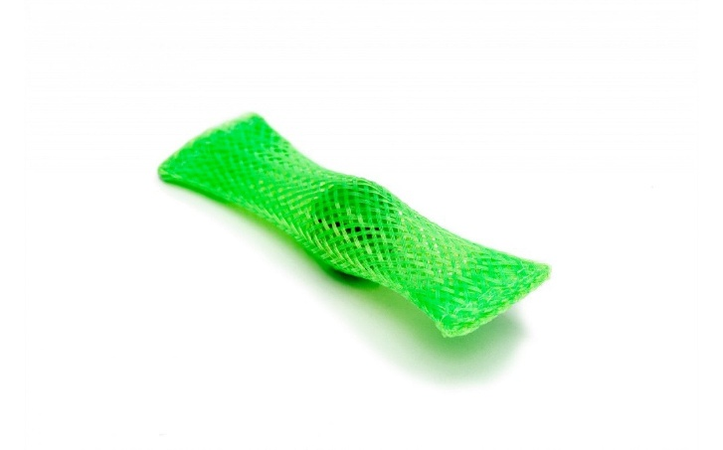
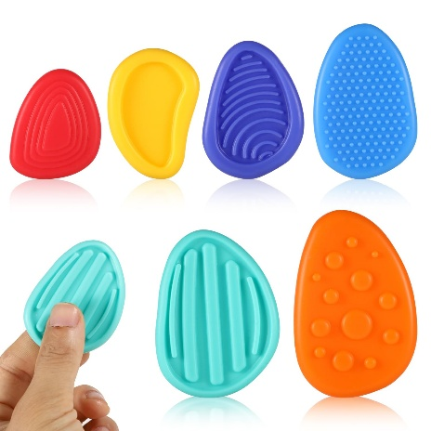
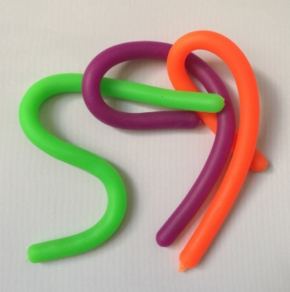
Fidget Tools
Some children are offered a ‘fidget tool’ in class to keep their hands busy while needing to focus for a longer period of listening
These will be given out by the school, as judged beneficial by the class teacher or SENDCO
Please do not send in a fidget toy from home, but if you suspect your child may benefit from one, you are welcome to drop us an email and we will monitor their needs and supply one if we feel it will have a beneficial effect. In practice, some children are more distracted by the fidget item itself than they are without it!
We have other tools in school that can support children, especially those with Special Educational Needs and Disabilities, which will be provided as necessary

Slide 13
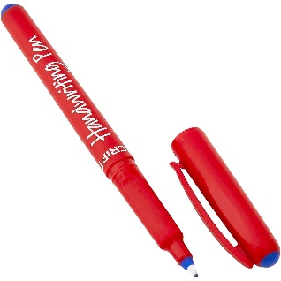

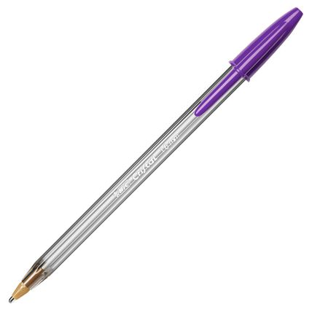

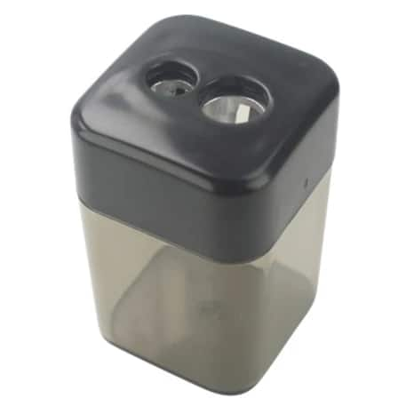
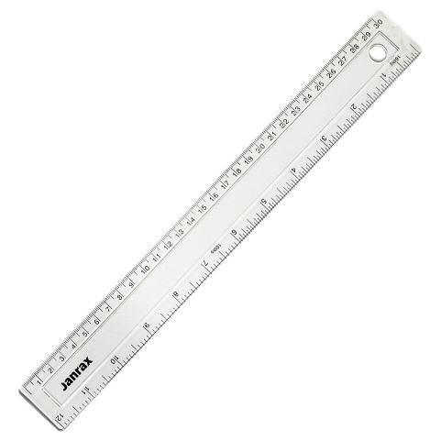

Pencil Cases
In Year Six, children are welcome to bring in a pencil case from home
However, if they do not wish to, we have all the necessary equipment available ☺
Children who bring their own pencil case will need either a pencil or a handwriting pen (not biro) to write with and a pencil for maths
They are welcome to use a pencil grip that suits them
They would also benefit from a ruler, eraser, and possibly a small gluestick
If they bring a pencil sharpener, please ensure it is not electric-powered
We use ‘purple polishing pens’ to edit our work, which we can supply or they can bring in their own – this is the only biro we use
We occasionally use highlighters, protractors and colour pencils, but there is no need to buy unless you wish to

Slide 14
Progress reports
There are two formal parents’ evenings in the Autumn and Spring terms; these are an opportunity to discuss progress, successes, areas for development and strategies moving forward alongside any pastoral areas. Your child’s individual targets will also be shared with you at these meetings.
There is an additional open evening for parents in the Summer term to visit your child’s current class teacher and meet the new teacher for the coming year.
Formal reports are produced during the Summer term and will give an overview of your child’s attainment in all subjects, a personal comment from the teacher and Headteacher, and targets for the year ahead.
I can’t do it …YET!

Slide 15
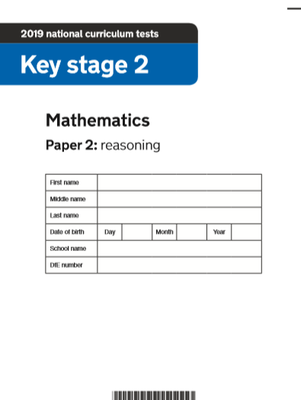
Assessment
As you will no doubt be aware, it is during Year Six that children sit their KS2 SATs assessments. Although the year will of course include preparation for these tests, please be assured that as a school we take into account the children’s work in books and their contributions in class as well as their results in any formal tests.
The final SATs tests are sat in the month of May, although there will be baseline testing earlier in the year when the other year groups take their termly assessments.
Some children will qualify for additional support such as extra time allowance or a grown-up to help with reading questions or just for moral support. These arrangements will be made nearer the time and we are held to the standards of the STA so children must meets specific requirements to qualify and this is not our decision.
Our focus is always on the children making progress and enjoying their learning, so we encourage them to see any assessments as opportunities for ‘showing off’ their progress and to take pride in their effort. We encourage you as parents to speak positively about tests and, as you already do, value all their many skills and talents that make them special so that the year does not become one long road to SATs!

Slide 16
Residential visit
….
More information to follow!

Slide 17
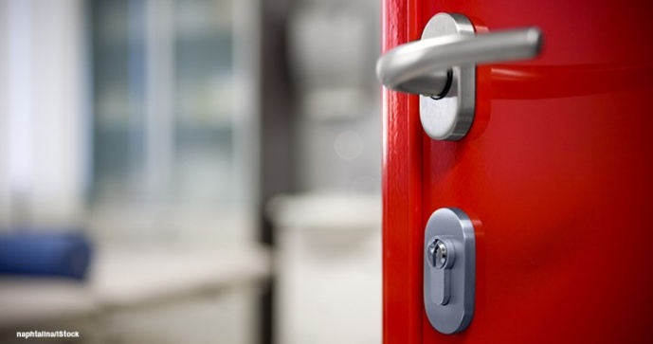
Communication
Please contact the class teacher first with any questions or worries.
For short questions / messages:
catch us at drop-off or pick-up times
use the class email address year6@woottonpri.iow.sch.uk (checked 8:30 – 4:00)
For longer conversations:
please arrange with the class teacher to meet after school or talk on the phone.
Our weekly newsletter includes an update from each teacher on what the children have been learning alongside important messages from the Headteacher.
The school Facebook page also celebrates learning each week and often includes photographs of the children enjoying their lessons and educational visits.
Please keep the office updated with your contact details so you don’t miss any important messages ☺

Slide 18
We are looking forward to a great year in
Capaldi Class ☺
Please feel free to ask any questions now, pop them on a post-it, or drop me an email:
year6@woottonpri.iow.sch.uk
Thank you

